Slide 1
CSE 5112
Digital Signal and
Image Processing
Module 1 · Foundations of Digital Signal Processing
Overview · Analog signal analysis · Discrete-time signals and systems · Sampling and reconstruction
Md. Atiqur Rahman, PhD
Associate Professor, Department of Computer Science and Engineering
Islamic University, Kushtia, Bangladesh
Notes:
Opening slide. Introduce the module and state the promise: by the end of these four topics students will be able to explain exactly what is lost, and what is not lost, when an analog signal is turned into numbers.

Slide 2
Where Module 1 sits in the course
There are twelve topics in all. These four come first, and everything later stands on them.
1
Foundations
2
Transforms
3
Filter analysis
4
Filter design
Overview of DSP
Analog signal analysis
Discrete-time signals and systems
Sampling and reconstruction
z transform
Discrete-time Fourier transform
DFS, DFT and the fast Fourier transform
Responses of digital filters
Realization structures
FIR filter design
IIR filter design
Tools and applications
CSE 5112 · Module 1 · Foundations of DSP
3
Notes:
Give the map once and return to it at every module boundary. The key point matters: Module 1 is not warm-up material. Convolution and the sampling theorem are used in every later derivation, so weakness here compounds.

Slide 3
CHAPTER ONE
1
Overview of Digital
Signal Processing
Intended learning outcomes
Understand the basic terminology of digital signal processing
Distinguish digital from analog signal processing and state the trade-offs
Describe the principal application areas and recognise them in practice
Notes:
Chapter 1 is short and conceptual. Its job is to give students the vocabulary and the motivation before the mathematics starts in Chapter 2.

Slide 4
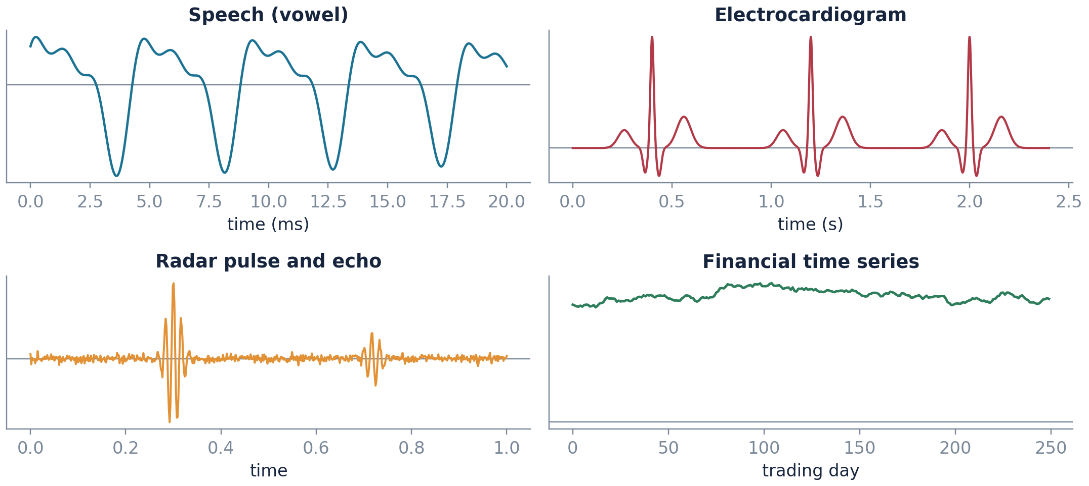
What is a signal?
A signal is anything that changes over time or space and tells you something
Independent variable
Usually time. It can also be space in an image, depth in a seismic trace, or position in a DNA sequence.
Dimensionality
Audio needs one axis, a photo needs two, and video needs three.
Channels
One signal, or many at once. Stereo sound, a 64-lead EEG, and a colour image all carry several signals together.
Four signals from four disciplines. All four are just functions of an independent variable.
CSE 5112 · Module 1 · Foundations of DSP
9
Notes:
Ask the class for signals from their own domain before showing the figure. The point to land is that signal processing is domain-agnostic: the same convolution sum denoises an ECG and sharpens a photograph.

Slide 5
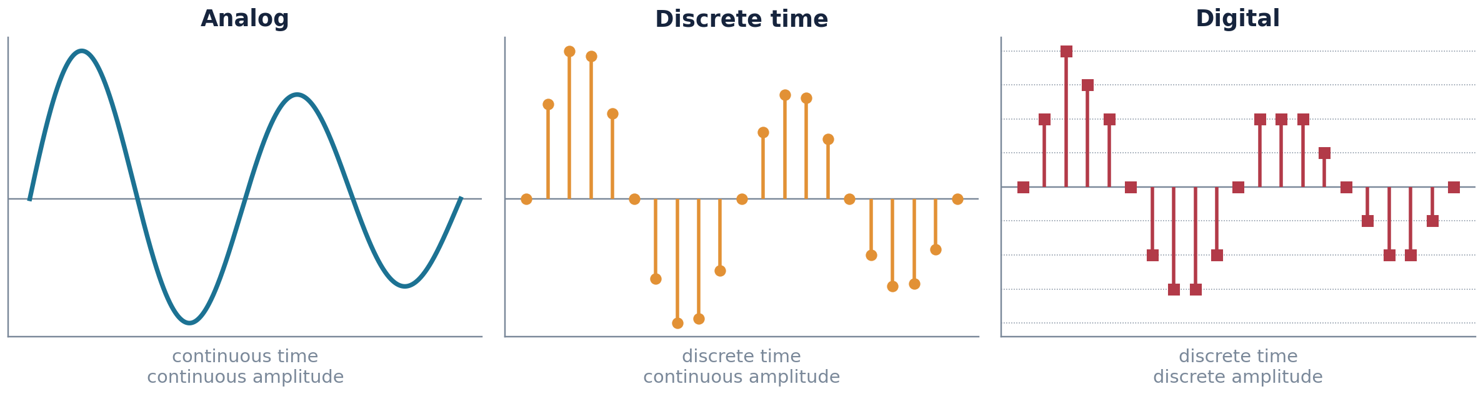
Three kinds of signal, and why the distinction matters
Time can be smooth or in steps. Height can be smooth or in steps. That gives three useful kinds.
Analog
Discrete-time
Digital
Has a value at every single instant, and that value can be anything at all. This is what a microphone or a thermocouple really produces.
Has a value only at the sampling instants, but each value is still exact. This is a useful idea on paper, not something you can build.
Has a value only at the sampling instants, and each value must be one from a fixed list. This is what a computer can store.
CSE 5112 · Module 1 · Foundations of DSP
10
Notes:
Students routinely use discrete-time and digital as synonyms. They are not. Almost all of this course analyses discrete-time signals with exact amplitudes; quantization is treated separately at the end of Chapter 4 precisely because it is a different kind of error.

Slide 6
The same idea in everyday terms
Three pairs you already know, all showing the same one difference
A vinyl record against a music file
The groove in a record is a continuous physical curve; the needle follows it exactly. A music file is a long list of numbers, taken tens of thousands of times a second. Played back through good equipment most listeners cannot tell them apart, which is the sampling theorem doing its work.
A mercury thermometer against a digital one
The mercury column can sit anywhere on the scale. The digital display shows 36.7 and never 36.734. Both are measuring the same temperature; one has been rounded to a fixed number of decimal places. That rounding is quantization.
A painting against a photograph on a screen
Move close enough to the screen and the picture breaks into a grid of coloured squares. Move close to the painting and it does not. The screen has sampled space instead of time, which is exactly what the image processing half of this course is about.
CSE 5112 · Module 1 · Foundations of DSP
11
Notes:
Ask which of the three pairs is closest to the students' own field. Civil and mechanical students usually recognise the thermometer, computer science students the screen, and everyone recognises the music example.

Slide 7
The digital signal processing chain
Every real system, from a hearing aid to a radar, is built from these same blocks
Analog
input
Anti-alias
filter
Sample
and hold
Quantizer
(ADC)
Digital
processor
DAC and
hold
Reconstruction
filter
sensor output
x(t)
removes energy
above fₛ/2
continuous time
to x[n]
B bits per
sample
the algorithm
y[n] = T{x[n]}
back to a
staircase
smooths to
y(t)
Analog domain
Digital domain
Analog domain
Chapter 4 owns the two ends
Chapters 3 and 5 to 11 own the middle
Nothing here is optional
The anti-alias filter, the sampler, the quantizer, and the reconstruction filter are all analysed in the fourth chapter of this module.
The processor block is where difference equations, transforms, and filter design live. It is the part you get to program.
Leave out the anti-alias filter and even a perfect algorithm gives wrong answers. What goes wrong at the two ends cannot be fixed in the middle.
CSE 5112 · Module 1 · Foundations of DSP
13
Notes:
Draw this on the board before showing the slide, and keep returning to it. Whenever a student asks why a topic matters, point at the block it belongs to. The last card is the one to press hard: aliasing is unrecoverable.

Slide 8
Analog against digital processing
Digital is better at most things. It is not better at everything.
Criterion
Analog processing
Digital processing
Accuracy
Set by component tolerance, drifts with temperature and age
Set by word length; exactly repeatable across devices and decades
Flexibility
Changing behaviour means changing hardware
Changing behaviour means changing a coefficient array
Complex operations
Adaptive, nonlinear, and data-dependent processing is hard
Adaptive filtering, compression, and machine learning are routine
Storage and transport
Copies degrade; storage is bulky
Lossless copies, error-correcting codes, cheap storage
Speed and bandwidth
Naturally handles very high frequency signals
Limited by converter rate and processor throughput
Power and cost
Very low power for simple tasks
Converters and processors add power, cost, and latency
Read this honestly Digital wins on flexibility, repeatability, and the sheer range of things it can do. It loses on speed, on delay, and on power for simple jobs. That is why a radio front end is still analog today.
CSE 5112 · Module 1 · Foundations of DSP
14
Notes:
Resist the temptation to present this as digital being simply better. Ask students where an analog low-pass filter is still the right answer; the anti-alias filter on the very next chain diagram is one, and it cannot be done digitally by construction.

Slide 9
Where digital signal processing is used
Six very different fields, all using the same small set of tools
1
Speech and audio
2
Biomedical
3
Communications
Squeezing speech for mobile calls, removing background noise, cancelling echo, feeding speech recognisers, making music.
Cleaning up ECG and EEG traces, spotting abnormal heartbeats, building medical images, hearing aids, microscope pictures.
Putting data onto a radio wave and taking it off again, correcting for the channel, staying in step, fixing errors.
4
Radar, sonar, seismics
5
Image and video
6
Instrumentation
Sharpening the returned pulse, working out which direction it came from, tracking targets, imaging underground.
Cleaning up photos, compressing them, finding edges and features, lining two images up, and every convolutional network.
Spectrum analysers, vibration monitors on machines, checking mains power quality, and sensing inside control loops.
CSE 5112 · Module 1 · Foundations of DSP
15
Notes:
Pick the domain closest to the class research interests and expand on that one. The fifth card is the bridge to the image processing half of this course, so flag it explicitly.

Slide 10
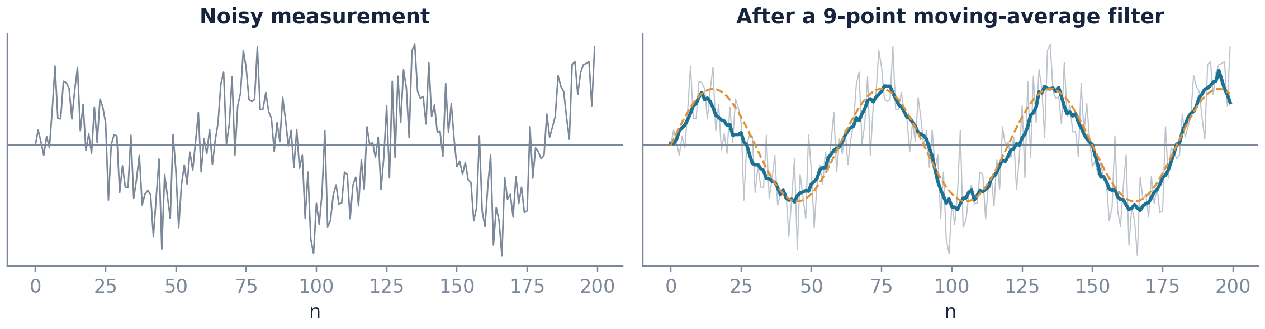
A first taste: noise reduction in three lines
Nine lines of code that work. The rest of this module explains why they work.
% moving-average smoother
n = 0:199;
x = sin(2*pi*n/60);
xn = x + 0.55*randn(1,200);
% the filter itself
h = ones(1,9)/9;
y = conv(xn, h, 'same');
plot(n, y)
Why does averaging help?
Why nine points and not ninety?
Why is the output delayed?
Chapter 3: convolution and the impulse response.
Chapter 6: the filter has a frequency response, and it has a shape.
Chapter 8 and Chapter 10: phase response and linear phase.
CSE 5112 · Module 1 · Foundations of DSP
16
Notes:
Run this live if you can. The pedagogical move is to show a working result first and then spend the semester justifying it. Note the three questions on the slide are answered in three different later chapters, which motivates the whole syllabus.

Slide 11
CHAPTER TWO
2
Review of Analog
Signal Analysis
Intended learning outcomes
Classify analog signals as periodic or aperiodic, and as energy or power signals
Compute Fourier series coefficients and interpret the resulting line spectrum
Apply the continuous-time Fourier transform and its principal properties
Relate convolution in time to multiplication in frequency for LTI systems
Notes:
This chapter is revision for most students, but do not skip it. Every discrete-time result in Chapters 3 to 7 is built by analogy with a continuous-time result stated here, and the sampling theorem cannot be derived without the Fourier transform.

Slide 12
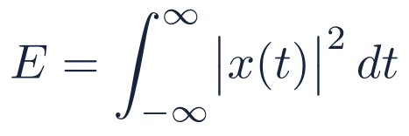
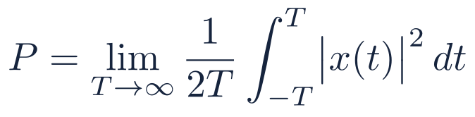
Periodicity, energy, and power
Three labels. Which one a signal gets decides which tool you are allowed to use.
Energy signals
Power signals
Total energy adds up to a finite number. These are short events: taps, pulses, and things that die away. The Fourier transform works on them directly.
Energy adds up to infinity, but the average power is finite. Anything that goes on forever, including all repeating signals and most noise.
Periodicity
A signal is periodic if it repeats exactly after some time T₀. The smallest such T₀ is called the period, and f₀ = 1/T₀ is how many times it repeats per second.
Add two repeating signals together and the result repeats only if their two periods divide into each other neatly. Otherwise the sum never repeats at all.
No signal is both an energy signal and a power signal. A few, such as a straight ramp going up forever, are neither.
Common error Decide which of the two classes a signal belongs to before you pick a tool. Push a never-ending signal through the Fourier transform integral and you get spikes rather than a sensible curve.
CSE 5112 · Module 1 · Foundations of DSP
18
Notes:
Worth a quick board exercise: is cos(2 pi t) + cos(2 pi t times sqrt 2) periodic? No, because the ratio of periods is irrational. Students almost always answer yes on reflex.

Slide 13
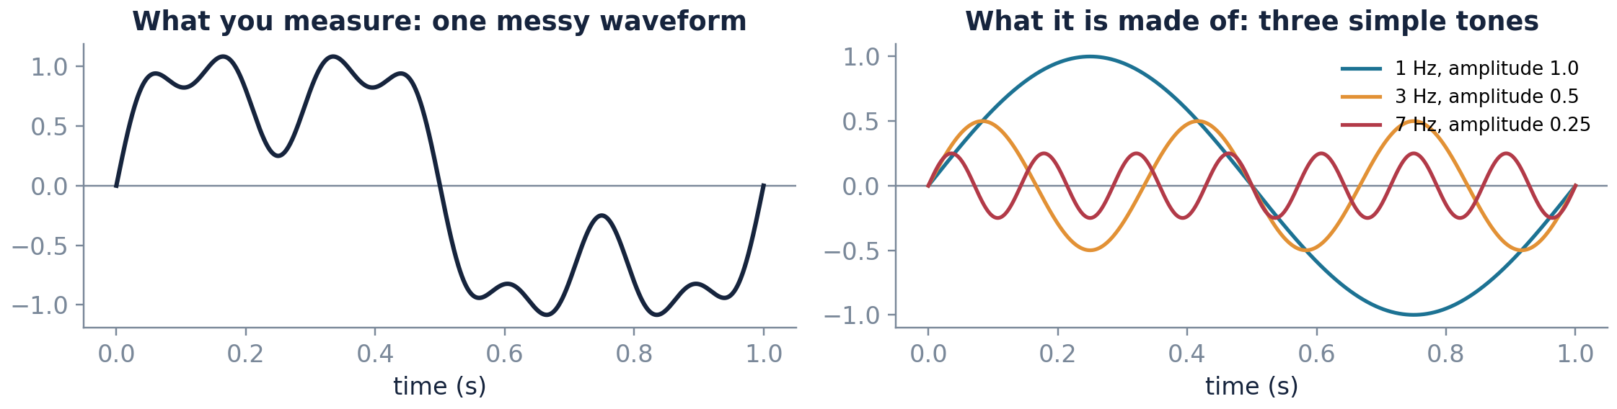
Before the formulas: why frequency at all?
A prism splits white light into colours. Fourier analysis does the same to a signal.
The prism idea
White light looks like one thing until you put a prism in front of it, and then it separates into colours that were there all along. A signal behaves the same way. The waveform on the left below looks complicated, and yet it is nothing more than three simple tones added together. Fourier analysis is the prism: it takes a measured waveform and tells you which simple tones it is made of, and how much of each.
Why bother separating them
Because problems are usually easy to state in terms of tones and hard to state in terms of the waveform. Remove the mains hum means remove the 50 hertz component. Improve the bass means increase the low-frequency components. Neither instruction has any simple meaning if you only look at the waveform, and both become one-line instructions once the signal has been separated.
CSE 5112 · Module 1 · Foundations of DSP
19
Notes:
Do not move on until the prism picture has landed. Students from non-electrical majors often work through the whole of Fourier analysis without ever being told, in one sentence, what it is for.

Slide 14
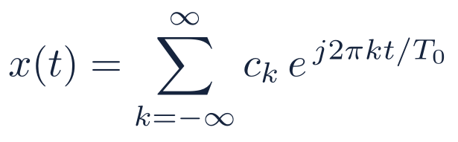
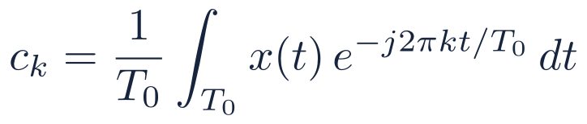
Fourier series: periodic signals are sums of harmonics
Any repeating signal is a sum of simple waves. These two formulas say how much of each.
(2.2)
(2.1)
Synthesis: build the signal from harmonics
Analysis: extract the weight of each harmonic
Each cₖ is a complex number. Its length tells you how strong that wave is, and its angle tells you where that wave starts.
If the signal is real, which every measured signal is, the picture is symmetric about zero. So the negative-frequency half carries no new information.
Energy sits only at f₀, 2f₀, 3f₀ and so on, and nowhere in between. That gap-and-spike pattern is the signature of a repeating signal.
There are conditions under which this is guaranteed to work. Every signal you will ever measure satisfies them, so you can stop worrying about it.
CSE 5112 · Module 1 · Foundations of DSP
20
Notes:
Emphasise the analysis and synthesis pairing, because the same pairing recurs for the Fourier transform, the DTFT, the DFT, and the z transform. Students who see the pattern once stop memorising four separate formula pairs.

Slide 15
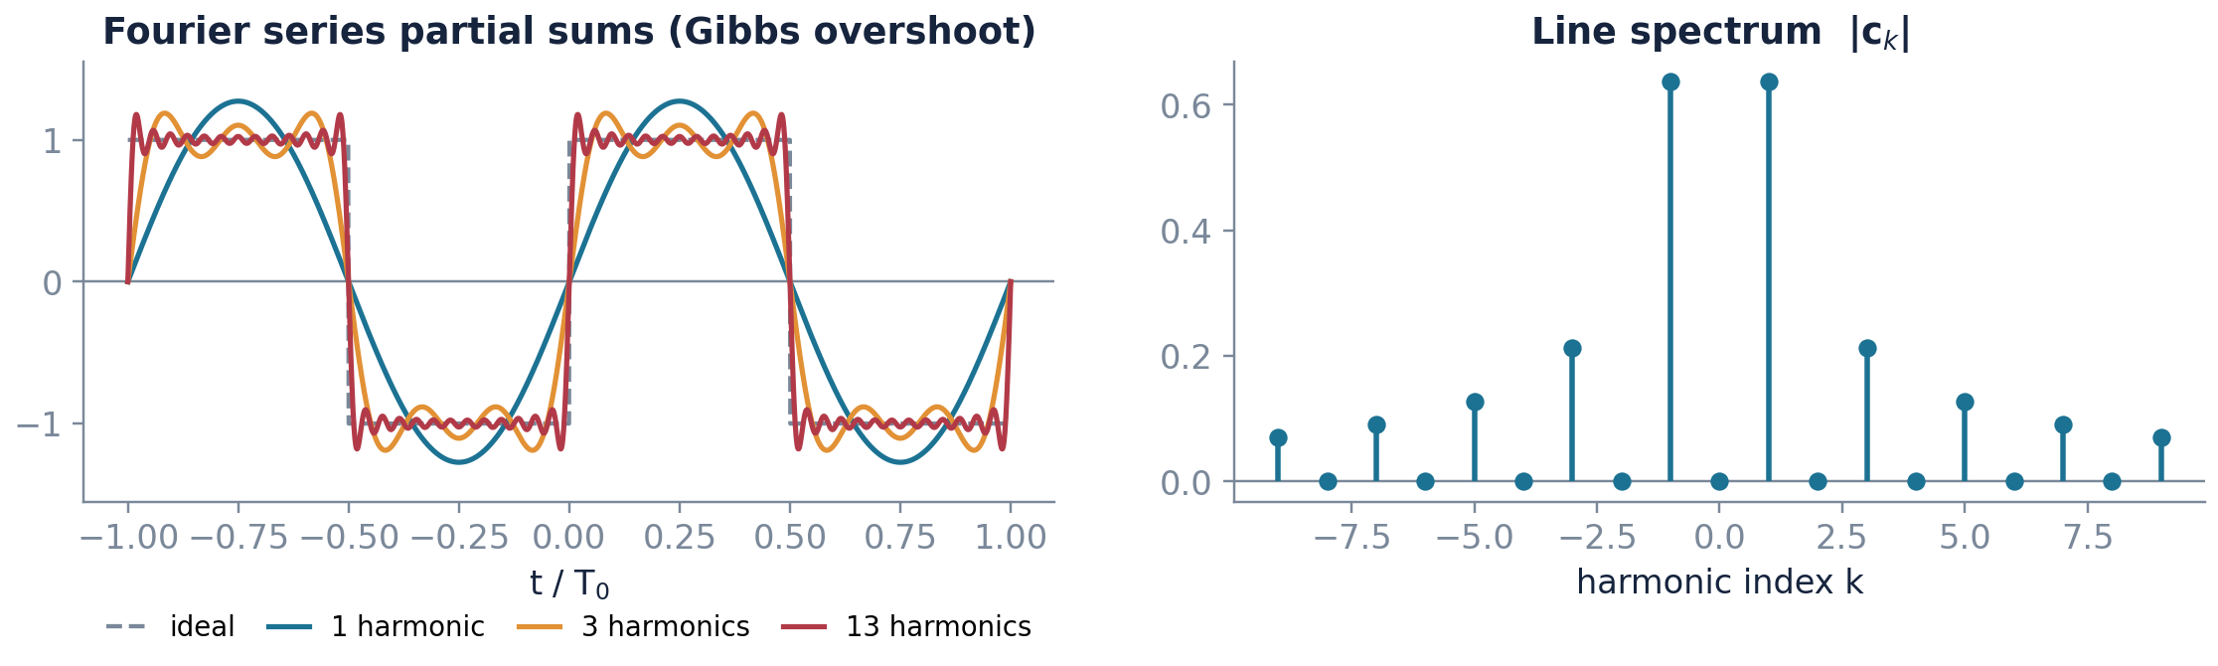
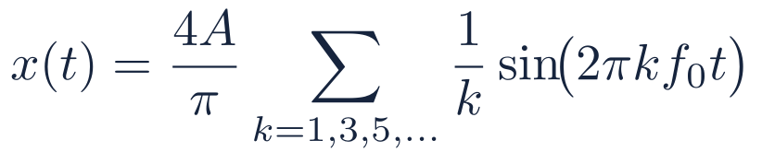
Worked example: the square wave
A sharp corner needs an endless number of waves to build
The Gibbs phenomenon
Right at the jump the sum always overshoots by about nine percent. Adding more waves makes the wobble narrower but never shorter. This is real, not a computer error.
Key point Only the odd waves appear, and they fade slowly as 1/k. Slow fading in frequency always means a sharp corner in time. Remember this in Chapter 10, when a filter with a sharp cutoff turns out to need a very long impulse response.
CSE 5112 · Module 1 · Foundations of DSP
21
Notes:
The Gibbs overshoot returns in Chapter 10 as the reason rectangular windowing gives poor stopband attenuation, and the fix there, tapered windows, is the same fix as here. Plant the seed now.

Slide 16
How to read a spectrum plot
The left-to-right axis shows speed, not time. Getting that wrong costs marks.
1
The horizontal axis is frequency, not time
2
The height is how much of that frequency is present
This is the single most common misreading. Moving right does not mean later; it means faster. A spike far to the right is a fast wiggle somewhere in the signal, but the plot says nothing about when it occurred.
Tall means that tone is strong in the signal. Zero height means that tone is simply absent. The units are whatever the signal's units were, so height is comparable across the same plot but not across different signals.
3
Spikes mean periodic, spread means one-off
4
There is a second plot you are not being shown
A signal that repeats forever gives isolated spikes, because only exact harmonics of the repetition rate are present. A short pulse or a transient smears energy across a wide continuous band. Narrow in time always means wide in frequency.
Every spectrum has a magnitude part and a phase part. Most textbook figures print only the magnitude, because it is easier to interpret. The phase carries the timing information, and Chapter 8 shows what goes wrong when a filter mishandles it.
Plain words
A spectrum is an ingredients list. The horizontal position names the ingredient and the height says how much of it went in. It does not tell you the order the cook added them, and for that you need the phase plot.
CSE 5112 · Module 1 · Foundations of DSP
22
Notes:
Put a real spectrum on screen from any measurement in your own research and walk the class through it using these four rules. The transfer from textbook figure to real data is where most of the confusion lives.

Slide 17

From Fourier series to Fourier transform, slowly
Stretch the repeat time until it is infinite, and the spikes join up into a curve
1
Start with something that repeats
Fourier series only applies to a signal that repeats forever with period T₀. Its spectrum is a set of isolated spikes at 0, f₀, 2f₀, 3f₀ and so on, where f₀ = 1/T₀.
2
Now stretch the period
Suppose the repetition gets slower: T₀ doubles, then doubles again. The spikes stay in the same places relative to each other, but the spacing f₀ between them shrinks each time. The picture fills in.
3
Take the stretch to the limit
Let T₀ grow without bound. The signal now repeats so rarely that it effectively happens once. The spike spacing shrinks to zero and the isolated spikes merge into a continuous curve.
4
Rename what you have
That continuous curve is the Fourier transform. The sum over harmonics has become an integral over frequency, and the coefficients cₖ have become a function X(jΩ). Nothing new was invented; a discrete list became a continuous curve.
Why this is worth ten minutes
Most students learn these as two separate formulas. They are one idea at two settings of a single dial, and the dial is the period. Repeating signals give spikes, one-off signals give curves, and the rest follows.
CSE 5112 · Module 1 · Foundations of DSP
23
Notes:
Sketch the four spectra side by side on the board as the period doubles. Seeing the spikes crowd together and merge is far more persuasive than the limiting algebra, which most students cannot follow on a first pass anyway.

Slide 18
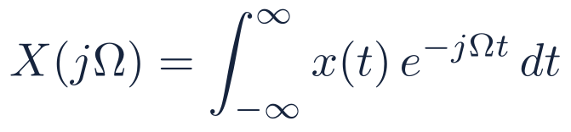
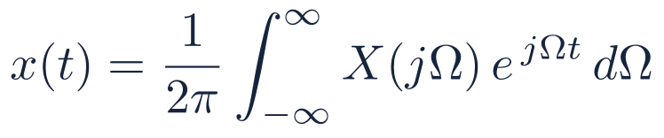
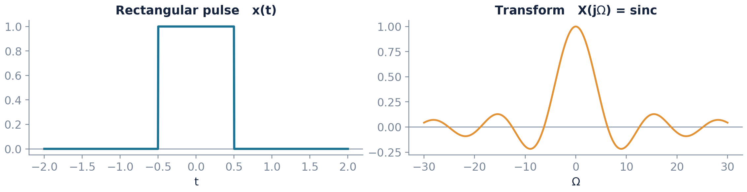
The continuous-time Fourier transform
The same idea as Fourier series, but for a signal that happens only once
(2.3)
(2.4)
Forward transform (analysis)
Inverse transform (synthesis)
A rectangular pulse and its transform. Narrow in time means wide in frequency, and this reciprocity has no exceptions.
CSE 5112 · Module 1 · Foundations of DSP
24
Notes:
Stress the units. Omega is in radians per second, not hertz. Half the sign errors in student work come from mixing Omega and 2 pi f, and the habit of writing units next to every symbol prevents most of them.

Slide 19
Properties you will use constantly
Seven shortcuts. The convolution row is the reason this whole subject exists.
Property
Time domain
Frequency domain
Why it matters
Linearity
a x₁(t) + b x₂(t)
a X₁(jΩ) + b X₂(jΩ)
Superposition survives the transform
Time shift
x(t − t₀)
X(jΩ) e⁻ʲΩᵗ₀
Delay changes phase only, never magnitude
Frequency shift
x(t) eʲΩ₀ᵗ
X(j(Ω − Ω₀))
The basis of every modulation scheme
Time scaling
x(at)
(1/|a|) X(jΩ/a)
Compress in time, stretch in frequency
Convolution
x(t) * h(t)
X(jΩ) H(jΩ)
The single most important row on this slide
Multiplication
x(t) w(t)
(1/2π) X(jΩ) * W(jΩ)
Why windowing smears a spectrum
Differentiation
dx(t)/dt
jΩ X(jΩ)
High frequencies amplified, hence noisy
Key point The convolution row is the whole reason we bother with frequency at all. Something that costs a difficult integral in time costs one multiplication in frequency, and every filter design method in this course trades on that.
CSE 5112 · Module 1 · Foundations of DSP
25
Notes:
Do not have students memorise this table. Have them derive the time-shift property once on the board; the rest follow the same pattern and the derivation is more durable than the memory.

Slide 20
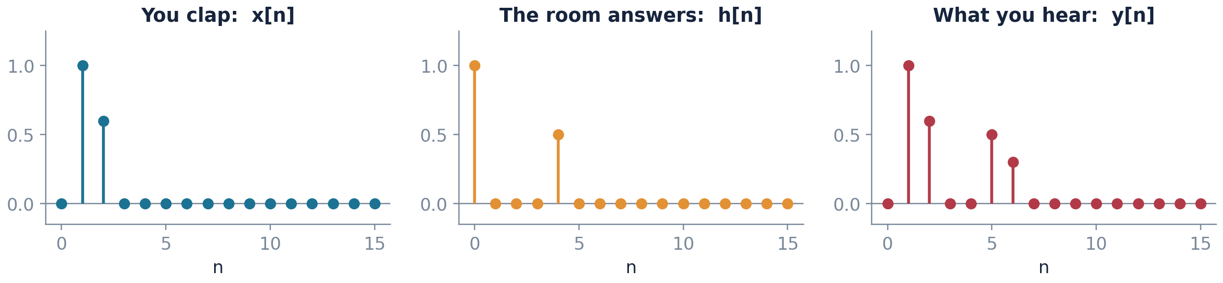
Convolution, in words before symbols
Clap once in an empty hall. What comes back explains the whole idea.
Picture a large empty hall
You clap once. What you hear back is not a single clap. There is the original sound, then a reflection off the far wall a moment later and quieter, then more reflections, each later and quieter still. That whole pattern of responses to one clap is the room's impulse response. It is a property of the room and has nothing to do with what sound you made.
Now play music in that hall
Music is just a great many little sounds, one after another. The room does the same thing to every one of them: it produces a delayed, scaled copy of its echo pattern for each. What reaches your ear is all of those overlapping copies added together.
That adding-up is convolution
The formula says exactly this and nothing more. For each moment in the input, lay down a scaled copy of the impulse response starting at that moment, then add all the copies. The integral sign is there because in continuous time there are infinitely many moments, so the adding-up is an integral rather than a sum.
Plain words
Convolution answers one question: if I know how a system reacts to a single tap, what does it do to a whole stream of taps? The answer is always the same, add up a delayed and scaled copy of the reaction for every tap in the stream.
CSE 5112 · Module 1 · Foundations of DSP
26
Notes:
The hall example works because everybody has heard it. If your lecture room has any reverberation, clap once and let the class listen; that sound is literally h of t.

Slide 21
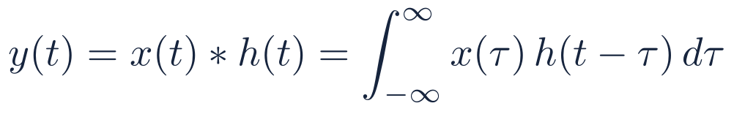
Linear time-invariant systems in continuous time
If a system is linear and time invariant, one measurement tells you everything about it
(2.5)
(2.6)
What LTI buys you
Why the transform helps
The transfer function
If a system is linear and time invariant, then measuring what it does to one single tap tells you what it will do to any input at all. No other kind of system is this generous.
The awkward combining operation in time becomes plain multiplication in frequency. Change domain, multiply, change back. It is usually faster, and it is far easier to see what the system is doing.
This is just the spectrum of the impulse response. Its height at each frequency says how much of that frequency gets through, and its angle says how much that frequency is delayed.
CSE 5112 · Module 1 · Foundations of DSP
27
Notes:
This slide is the continuous-time rehearsal for the central result of Chapter 3. Tell students explicitly that the discrete version replaces the integral with a sum and changes nothing else conceptually.

Slide 22
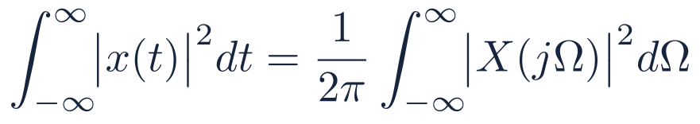
Parseval's relation, and what carries over to discrete time
Energy is the same in both domains, and here is what carries over to discrete time
(2.7)
The total energy is the same whichever domain you count it in. So work it out wherever the sum is easier.
Continuous-time concept
Discrete-time counterpart
Introduced in
Fourier series
Discrete Fourier series
Chapter 7
Continuous-time Fourier transform
Discrete-time Fourier transform
Chapter 6
Laplace transform
z transform
Chapter 5
Convolution integral
Convolution sum
Chapter 3
Analog filter design
IIR filter design by transformation
Chapter 11
Looking ahead None of Chapter 2 is wasted time. Every row above is a promise: the work you put into the analog side comes straight back in the discrete-time chapters.
CSE 5112 · Module 1 · Foundations of DSP
28
Notes:
End Chapter 2 with this table on screen while you take questions. It answers the perennial complaint that the analog review is a detour.

Slide 23
CHAPTER THREE
3
Discrete-Time Signals
and Systems
Intended learning outcomes
Generate and recognise the standard discrete-time sequences
Test a system for memory, stability, causality, linearity, and time invariance
Evaluate the convolution sum and interpret it as flip, shift, multiply, and sum
Relate difference equations to impulse responses and to system behaviour
Notes:
This is the longest and most important chapter of the module. Budget at least three lectures. If students leave with only one thing, it should be the convolution sum and what linearity plus time invariance buys.

Slide 24
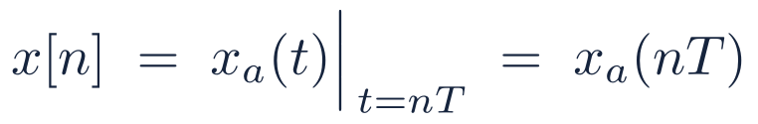
From xₐ(t) to x[n]
From a smooth curve to a plain list of numbers
(3.1)
Notation matters
The index has no units
Sequences need not come from sampling
Round brackets mean continuous time; square brackets mean discrete time. x(3) is a moment three seconds in. x[3] is the fourth number in a list. Keep them apart.
n is only a count. To get back to real time, multiply by the sampling period: t = nT. Forget the T and every frequency answer comes out wrong.
Daily rainfall figures, the pixels along one row of a photo, and numbers from a random generator are all perfectly good discrete-time signals. None came from sampling anything.
Key point From here to the end of the course, we work with x[n]. The analog signal shows up only twice more, both in Chapter 4: once when we sample it, and once when we build it back.
CSE 5112 · Module 1 · Foundations of DSP
30
Notes:
The bracket convention seems trivial and is not. Insist on it in marked work from the first assignment, because sloppy notation here produces genuine confusion in Chapter 4 when both domains appear in one equation.

Slide 25
What the index n actually means
n counts samples. It is not seconds. This is where most mistakes begin.
Suppose a sensor is read eight thousand times a second, so fₛ = 8000 Hz and the sampling period is T = 1/8000 = 0.125 milliseconds. The table shows the same instant described in three ways.
Sample index n
Real time t = nT
Written as
What it refers to
0
0 ms
x[0]
The first reading, taken when recording started
1
0.125 ms
x[1]
One sampling period later, not one second later
8
1.0 ms
x[8]
Eight samples in, one millisecond of real time
8000
1.0 s
x[8000]
One full second of recording
n
n × 0.125 ms
x[n]
The general case: real time t = nT always
The index carries no units
The same sequence can mean different things
n is a count. It is 8, not 8 seconds and not 8 hertz. The physical units live entirely in T, and if you drop T from a calculation the answer comes out wrong by a factor of the sampling rate.
The list of numbers 1, 4, 9, 2 says nothing about speed. Read at 8 kHz it is half a millisecond of audio; read once a day it is four days of rainfall. The sequence and the sampling rate are separate pieces of information and must be carried together.
CSE 5112 · Module 1 · Foundations of DSP
31
Notes:
Have students fill in one row of this table for the sampling rate used in their own discipline before the next lecture. Making it concrete once removes most of the unit confusion later.

Slide 26
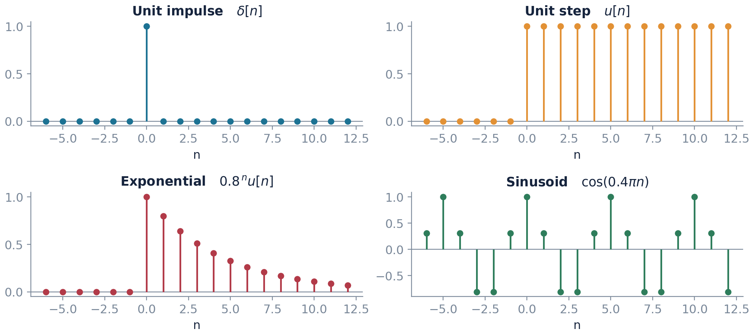
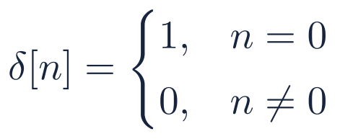
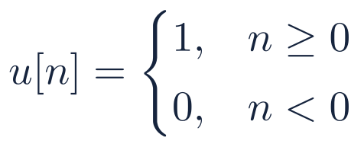


The standard sequences
Four simple signals. Almost everything else in the course is built from them.
(3.2)
(3.3)
(3.4)
(3.5)
Key point The unit impulse is the most useful of the four. Later in this chapter we show that if you know what a system does to δ[n] alone, you know what it does to anything.
CSE 5112 · Module 1 · Foundations of DSP
32
Notes:
Have students sketch 0.8 to the n times u[n minus 2] by hand before the next slide. Shifting and scaling a standard sequence is the single most common manipulation in the course and is best learned by repetition.

Slide 27
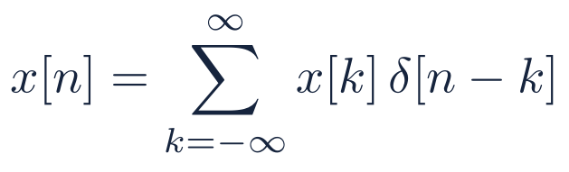
Every sequence is a sum of shifted impulses
Any signal is just a row of spikes. That one simple fact gives us convolution.
(3.6)
Read the right side literally. The piece x[k]δ[n − k] is one spike of height x[k], sitting at position k, and it is zero everywhere else.
Add up all those spikes and you get the original sequence back exactly, one sample at a time. Nothing has been rounded or approximated.
It looks like a statement that says nothing. It is actually the hinge of the whole chapter, because it writes any input at all as a set of scaled, shifted copies of one single test signal.
Now push the system through both sides. Linearity lets it go inside the sum. Time invariance turns its answer to δ[n − k] into h[n − k]. Two lines, and convolution appears.
Examinable This is a real proof, not a side comment. Be ready to write the two-line argument from linearity and time invariance to the convolution sum. It is a standard exam question.
CSE 5112 · Module 1 · Foundations of DSP
33
Notes:
Walk the argument slowly on the board: apply T to both sides, push T inside the sum using linearity, then use time invariance to replace T of delta[n minus k] with h[n minus k]. Two lines, and the central result of the course appears.

Slide 28
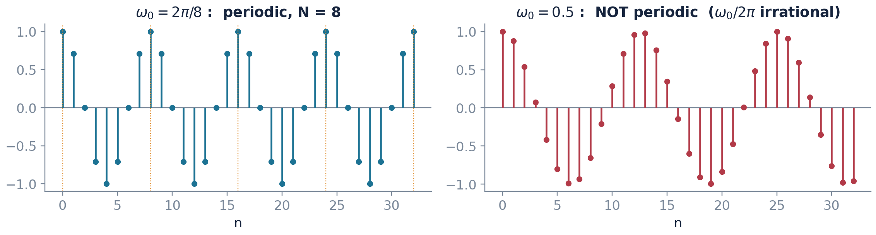
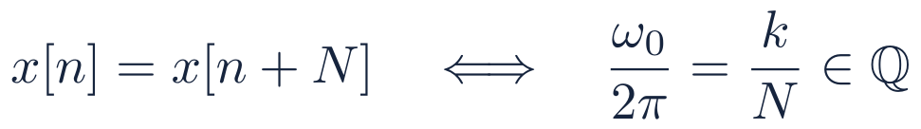
First surprise: a discrete sinusoid need not be periodic
In discrete time a cosine may never repeat, even though the picture looks like it should
(3.7)
cos(ω₀n) repeats only if ω₀/2π is one whole number divided by another. In continuous time, cos(ω₀t) always repeats, whatever ω₀ you choose.
When that fraction reduces to k/N, the sequence repeats every N samples. N can be surprisingly large even for a slow-looking wave.
CSE 5112 · Module 1 · Foundations of DSP
34
Notes:
The right-hand panel is worth pausing on. The samples clearly trace a cosine shape, yet the sequence never repeats exactly. Students find this genuinely counterintuitive, which is exactly why it is examinable.

Slide 29
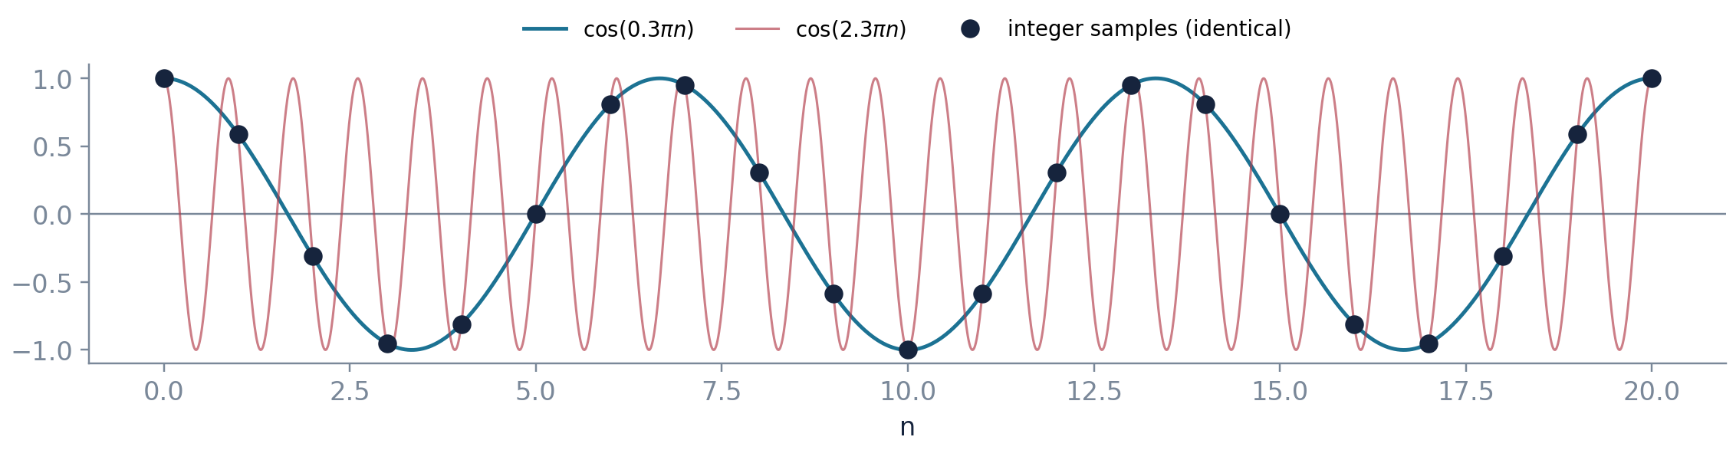
Second surprise: discrete frequency only lives on an interval of 2π
Two very different-looking frequencies can give exactly the same samples
(3.8)
Both curves go through exactly the same dots. As sequences of numbers they are the same signal, and no measurement could ever tell them apart.
So all of discrete-time frequency analysis fits inside one window of width 2π, and everything outside it is a repeat. That is why every spectrum from here on looks the same every 2π.
CSE 5112 · Module 1 · Foundations of DSP
35
Notes:
This slide is aliasing, seen from the discrete side, before we have derived it from the sampling side in Chapter 4. Connect the two explicitly when you reach the sampling theorem; students who see them as one phenomenon do far better.

Slide 30
CONSEQUENCE
The highest frequency a
discrete-time signal can carry
is ω = π
One radian per sample times pi means the sequence alternates sign at every step: +1, −1, +1, −1. Nothing can oscillate faster than that, because there is nothing between two consecutive samples. Push the frequency higher and the sequence starts to look slower again, which is aliasing.
Notes:
Have students write out cos(pi n) for n = 0 to 5 on paper. Seeing the alternating sequence appear makes the claim concrete in a way the algebra does not.

Slide 31
Five properties of a discrete-time system
Five yes-or-no questions to ask about any system before you trust a formula on it
1
Memoryless
The output right now depends only on the input right now. Squaring is memoryless. A moving average is not, because it looks back.
2
Causal
The output now depends only on inputs that have already arrived. You need this to run in real time. You do not need it when processing a saved file.
3
Stable
If the input stays within limits, the output stays within limits too. Without this a system is useless, however clever it looks.
4
Linear
Double the input and the output doubles. Add two inputs and the outputs add. Anything with a square, an absolute value, or an added constant fails this.
5
Time invariant
Delay the input and the output just shifts by the same amount, unchanged in shape. Any system whose behaviour depends on n fails this.
Key point Linearity and time invariance together are what let us use convolution at all. The other three tell you whether a system is usable, not whether the theory applies.
CSE 5112 · Module 1 · Foundations of DSP
37
Notes:
Insist that students state which property they are testing and give either a general proof or one explicit counterexample. A vague assertion that a system looks linear earns no marks.

Slide 32
How to run the two tests that matter
Linearity and time invariance. Each has one fixed recipe you follow every time.
Linearity
Time invariance
Feed x₁[n] and record y₁[n]; feed x₂[n] and record y₂[n].
Feed the combination ax₁[n] + bx₂[n] and compute the output directly.
Compare with ay₁[n] + by₂[n]. Equal for all a, b and all inputs means linear; one counterexample means not linear.
Compute the output for x[n], then delay that output by n₀.
Separately, delay the input first and compute the output of the delayed input.
The two must agree for every n₀. Any explicit n multiplying the input, as in y[n] = n x[n], breaks this immediately.
Key point Order of operations is the whole test for time invariance. Delay-then-process must equal process-then-delay.
CSE 5112 · Module 1 · Foundations of DSP
38
Notes:
Students frequently test time invariance by substituting n minus n0 into the output expression and stopping there. Make them write both quantities separately and compare, because the shortcut hides errors when n appears explicitly.

Slide 33
Worked test in full: is y[n] = x[n] + 3 linear?
Every line shown. Use the same four steps for any system you are given.
1
Write down what to compare
Linearity means one specific equality must hold. Feed in the combination and process it. Separately, process each input and then combine. The two results must match for every choice of a, b, x₁ and x₂.
2
Compute the left-hand side
Put a x₁[n] + b x₂[n] into the system. The rule says add 3 to whatever comes in, so the output is that combination plus a single 3.
3
Compute the right-hand side
Process each input separately: x₁ gives x₁[n] + 3 and x₂ gives x₂[n] + 3. Now scale by a and b and add. The constant appears twice, scaled, giving 3a + 3b.
4
Compare and conclude
The two sides agree only when 3 = 3a + 3b, that is only for particular a and b. Linearity requires agreement for all a and b, so this system is NOT linear. One counterexample, say a = b = 1, is enough to settle it.
Left-hand side: process the combination
Right-hand side: combine the separate outputs
CSE 5112 · Module 1 · Foundations of DSP
39
Notes:
Students protest that the graph of this system is a straight line, so surely it is linear. Address the objection directly: in systems theory linear means superposition holds, and a straight line through the origin is required. A line with an intercept is called affine, not linear.

Slide 34


Worked test in full: is y[n] = n x[n] time invariant?
The same four steps, now applied to the second test
1
State the two quantities
Route one: process the signal first, then delay the result by n₀. Route two: delay the signal first, then process it. Time invariance means the two routes must always give the same answer.
2
Route one, delay the output
First the system gives y[n] = n x[n]. Now delay that whole result by n₀, which means replacing every n by n − n₀, including the multiplying factor.
3
Route two, delay the input
Now feed the delayed signal x[n − n₀] into the system. The system multiplies whatever arrives by the current n, and the current n has not been delayed, because it belongs to the system and not to the signal.
4
Compare and conclude
One expression has the factor (n − n₀) and the other has the factor n. They differ unless n₀ = 0, so this system is NOT time invariant. The physical reading: the system's gain changes as time passes, so when a signal arrives changes what happens to it.
Route one: process, then delay
Route two: delay, then process
CSE 5112 · Module 1 · Foundations of DSP
40
Notes:
The rule of thumb students should leave with: if the letter n appears anywhere in the system rule other than inside a signal's brackets, the system is almost certainly not time invariant.

Slide 35
Worked example: classify these five systems
Five systems, four questions each. Cover the answers and try them first.
System
Linear
Time inv.
Causal
Stable
The reason
y[n] = x[n] + 3
no
yes
yes
yes
Constant offset breaks superposition, despite the name linear
y[n] = n x[n]
yes
no
yes
no
Explicit n makes the gain time-varying, and unbounded
y[n] = x[2n]
yes
no
no
yes
Downsampling needs future samples and is not shift invariant
y[n] = x²[n]
no
yes
yes
yes
Squaring is the classic nonlinearity
y[n] = Σ x[k], k ≤ n
yes
yes
yes
no
The accumulator: a bounded step input gives an unbounded ramp
Key point The last row is worth remembering. An accumulator passes three tests out of four and is still useless on its own, because it is not stable. The four properties are independent of each other.
CSE 5112 · Module 1 · Foundations of DSP
41
Notes:
Work rows one and five on the board and set the middle three as an exercise. Row one catches almost everybody, because the word linear in ordinary usage includes an intercept and in systems theory it does not.

Slide 36

Convolution again, now in discrete time
The same echo picture as before, but now with samples you can count
What the impulse response is, physically
Send a single spike into the system, one sample of height one surrounded by zeros, and record whatever comes out. That recording is h[n]. It is a measurement, not a piece of theory, and you could obtain it in a laboratory this afternoon.
Why one measurement is enough
Any input sequence is only a row of spikes of various heights, one per sample. Linearity says the system handles each spike independently and the outputs simply add. Time invariance says the response to a spike at position k is the same shape as the response to a spike at position 0, only shifted along by k.
So the recipe writes itself
For each input sample x[k], lay down a copy of h shifted to start at k and scaled by x[k]. Do that for every k, then add the whole pile up column by column. The number sitting in column n is y[n], and that statement is precisely the convolution sum.
Reading that example
The system above adds a half-strength copy of the input, delayed by four samples. Its impulse response has just two non-zero values: 1 at n = 0 and 0.5 at n = 4. A room with one strong echo is exactly this system.
CSE 5112 · Module 1 · Foundations of DSP
42
Notes:
Building the output as a pile of shifted scaled copies, then summing columns, is the mental model that makes the hand computation on the next slides feel obvious rather than arbitrary.

Slide 37
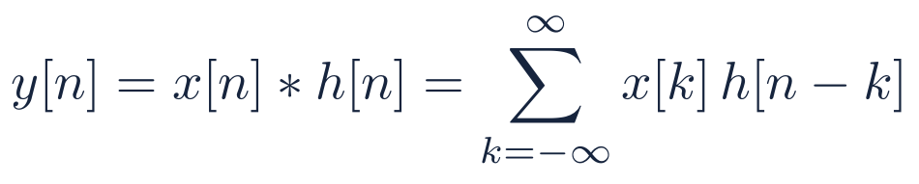
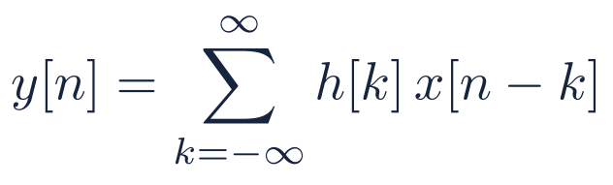
The convolution sum
The most important equation in this module
(3.9)
(3.10)
The two forms are equal: substitute m = n − k. Use whichever sequence is shorter as the one being flipped.
What h[n] is
What it gives you
What it costs
What comes out when you feed in one single spike. You can actually measure it: send in δ[n] and write down what appears.
It describes the system completely. Two systems with the same impulse response behave identically, no matter how differently they are built inside.
One sum of products for every single output sample. For long signals that is slow, which is exactly why the FFT in Chapter 7 was invented.
CSE 5112 · Module 1 · Foundations of DSP
43
Notes:
If a student remembers one equation from this module, it should be equation 3.9. Say so out loud. Then point out that the entire second half of the course is about computing it cheaply or designing h[n] deliberately.

Slide 38
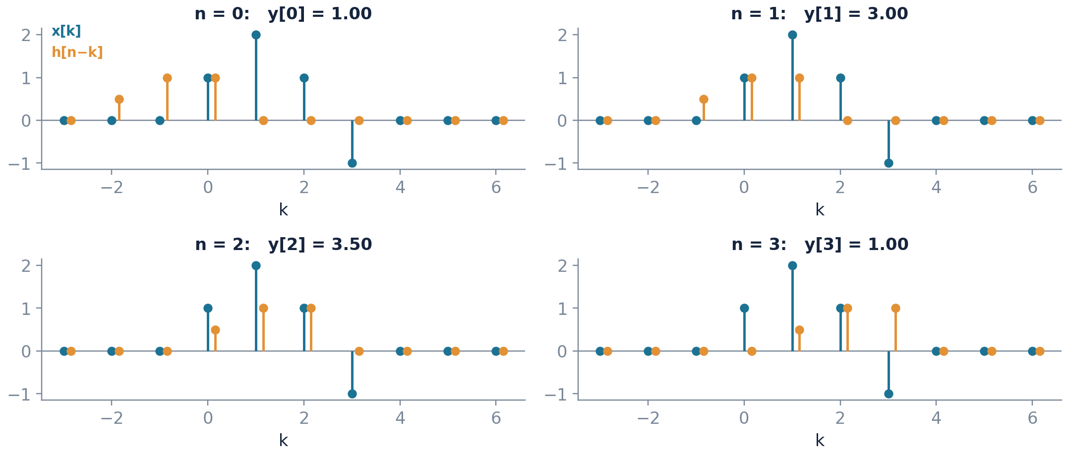
Computing it by hand: flip, shift, multiply, sum
x[n] = {1, 2, 1, −1} convolved with h[n] = {1, 1, 0.5}
1
Flip
Reflect h[k] about k = 0 to obtain h[−k].
2
Shift
Slide the flipped sequence right by n to get h[n − k].
3
Multiply
Form the product x[k]h[n − k] sample by sample.
4
Sum
Add the products. That single number is y[n].
5
Repeat
Advance n by one and do it again.
Key point Quick check on your answer: a signal of length L₁ convolved with one of length L₂ gives an output of length L₁ + L₂ − 1. Here 4 + 3 − 1 = 6. Count your answer before handing it in.
CSE 5112 · Module 1 · Foundations of DSP
44
Notes:
The four panels show n = 0 to 3. Ask the class to produce n = 4 and n = 5 and confirm the output has six samples. The length rule is the cheapest error check available and students should apply it every time.

Slide 39
A second method: convolution as a table
A second way to do it. Slower to explain, much harder to get wrong.
Write one row for each input sample. In the row for x[k], write the whole of h scaled by x[k], starting in column k. Then add each column. The column sums are the output. The same example as before: x = {1, 2, 1, −1} and h = {1, 1, 0.5}.
Contribution from
n = 0
n = 1
n = 2
n = 3
n = 4
n = 5
x[0] = 1
1
1
0.5
x[1] = 2
2
2
1
x[2] = 1
1
1
0.5
x[3] = −1
−1
−1
−0.5
y[n] = column sum
1
3
3.5
1
−0.5
−0.5
Why each row is shifted
Why the answer has six columns
When to prefer this method
The row for x[k] starts in column k because that copy of the impulse response begins when that input sample arrives, not before.
Four rows, each three long, staggered by one: 4 + 3 − 1 = 6. Count the columns before you start and you will know immediately if a term has gone missing.
Whenever both sequences are short and written out explicitly. The flip-and-slide picture is better for understanding; the table is better for getting the arithmetic right.
CSE 5112 · Module 1 · Foundations of DSP
45
Notes:
Most students end up preferring the table. Show both methods and let them choose, but insist they can explain why the rows are staggered, because that is where the understanding sits.

Slide 40
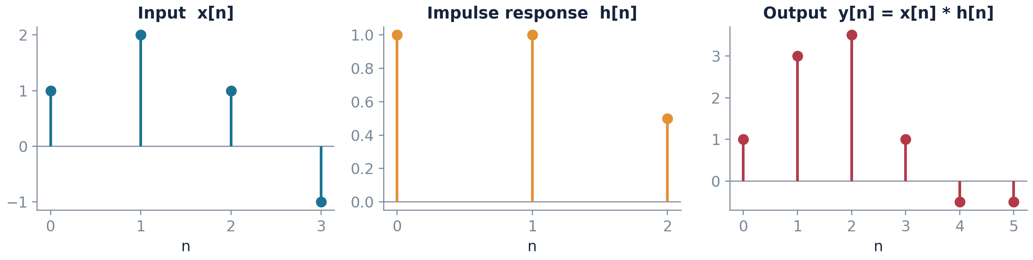
The result, and the properties worth knowing
y[n] = {1, 3, 3.5, 1, −0.5, −0.5}
Commutative
Associative
Distributive
Identity
x[n] * h[n] = h[n] * x[n]
(x * h₁) * h₂ = x * (h₁ * h₂)
x * (h₁ + h₂) = x * h₁ + x * h₂
x[n] * δ[n] = x[n]
Swap whichever is easier to flip
Cascaded systems merge into one
Parallel branches add
The impulse is the do-nothing system
CSE 5112 · Module 1 · Foundations of DSP
46
Notes:
The associative property is more practical than it looks: it is why a designer may implement one long filter as a cascade of short sections, which is exactly the topic of Chapter 9 on realization structures.

Slide 41

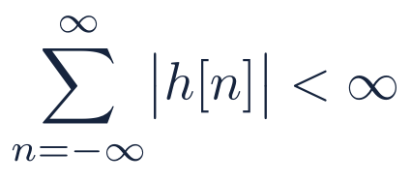
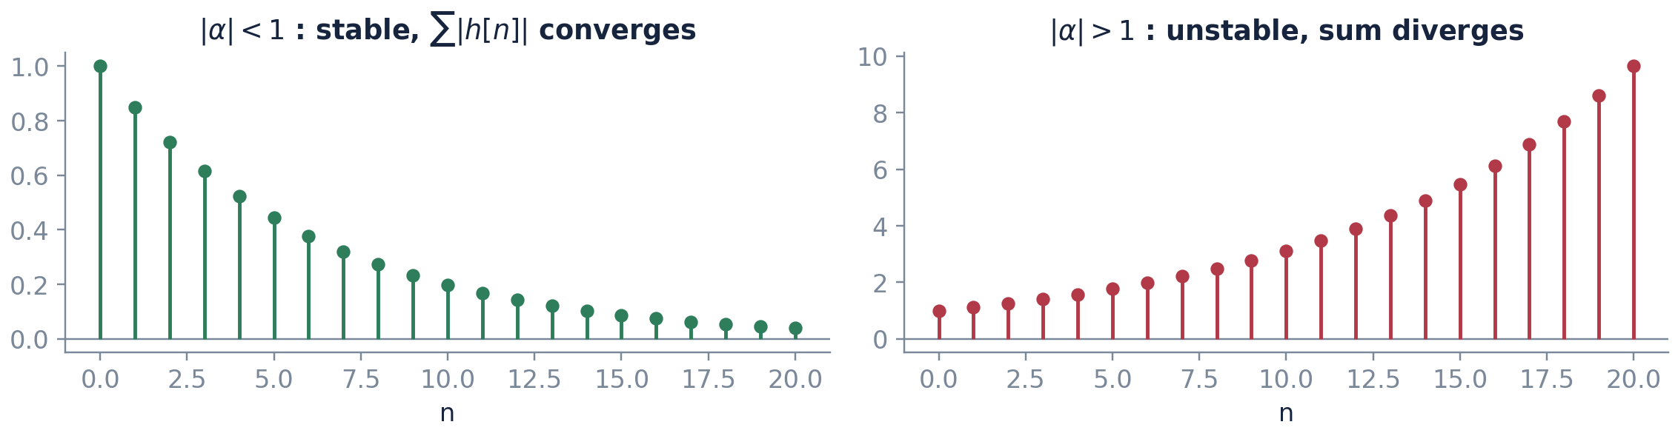
Causality and stability, read off the impulse response
Two questions about a system, and both are answered by looking at h[n]
Causality
Stability
Nothing comes out before the tap goes in. Needed for real-time work, not needed for stored data.
Add up the sizes of all the values in h[n]. If that total is finite, the system is stable. If not, it is not.
Fine print Fading away to zero is not enough. The sequence 1/n fades to zero, yet its total is infinite, so a system with that impulse response is unstable. Always check the total, not the picture.
CSE 5112 · Module 1 · Foundations of DSP
47
Notes:
The 1/n counterexample is worth doing carefully because it separates students who have understood the condition from those pattern-matching on decaying graphs. The harmonic series diverges; the graph looks perfectly well behaved.

Slide 42
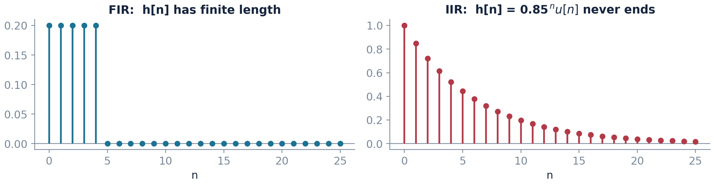
Finite and infinite impulse responses
Does the echo stop, or does it go on forever? That one question splits filters into two families.
FIR
IIR
Length of h[n]
Finite: h[n] = 0 outside a fixed window
Infinite: h[n] never becomes identically zero
Stability
Always stable, since a finite sum is always finite
Stable only if the coefficients are chosen with care
Phase
Exactly linear phase is achievable by symmetry
Linear phase is not achievable exactly
Cost for a given sharpness
Higher order, more multiplications per sample
Much lower order, feedback does the work
Designed in
Chapter 10, by windowing and frequency sampling
Chapter 11, by transforming analog prototypes
CSE 5112 · Module 1 · Foundations of DSP
48
Notes:
Students often ask which is better. The honest answer is that FIR is preferred wherever phase distortion matters, such as audio and biomedical work, and IIR wherever computation is scarce and phase is not critical, such as simple control loops.

Slide 43
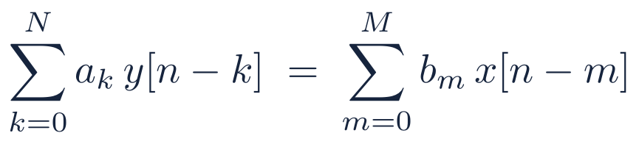
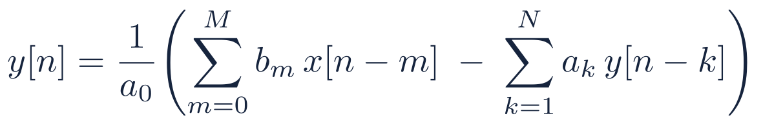
Difference equations: how systems are actually implemented
The line of arithmetic a processor actually runs, once for every sample
(3.11)
(3.12)
The first line is the general form. The coefficients being fixed numbers, and not changing with n, is exactly what makes the system time invariant.
Rearranged, it becomes a recipe you can run: each output is a weighted sum of the last few inputs and the last few outputs. That is all any digital filter ever does.
With no feedback term, the impulse response is simply the list of b coefficients, and the filter is FIR. Add feedback and the response usually goes on forever, giving IIR.
Where you start matters. The system counts as linear and time invariant only if it begins at rest, with all earlier outputs equal to zero.
CSE 5112 · Module 1 · Foundations of DSP
49
Notes:
Point out that equation 3.12 is literally the inner loop of every digital filter implementation students will ever write. Chapter 9 is about arranging that loop for numerical robustness and Chapters 10 and 11 are about choosing the coefficients.

Slide 44
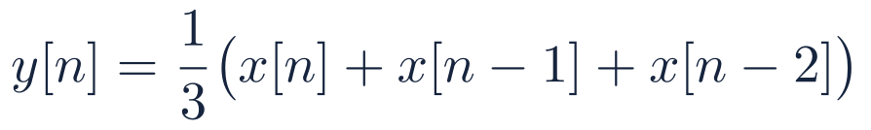
A difference equation is just a loop
The same filter written as maths, as a table, and as code
As mathematics
// as code, one output per loop pass
for (n = 2; n < N; n++) {
y[n] = ( x[n] + x[n-1] + x[n-2] ) / 3;
}
A three-point moving average: each output is the mean of the newest sample and the two before it.
Symbol in the equation
What it is
What it is in the running program
x[n]
The sample that has just arrived
Read it from the converter this instant
x[n−1], x[n−2]
Samples that arrived earlier
Held in memory; two stored numbers
y[n]
The output being produced now
Written to the converter this instant
y[n−1] and beyond
Previous outputs, when feedback is present
Also held in memory; this is what makes a filter IIR
The coefficients
The numbers doing the weighting
Fixed constants, chosen at design time in Chapters 10 and 11
Plain words
Designing a filter means choosing the numbers inside that loop, and nothing else. The rest of this course is either working out what a set of numbers will do, or choosing numbers to do what you want.
CSE 5112 · Module 1 · Foundations of DSP
50
Notes:
Computer science students relax visibly at this slide, and electrical students who have never implemented a filter get their first concrete picture of one. Worth showing early if your class is heavily mixed.

Slide 45
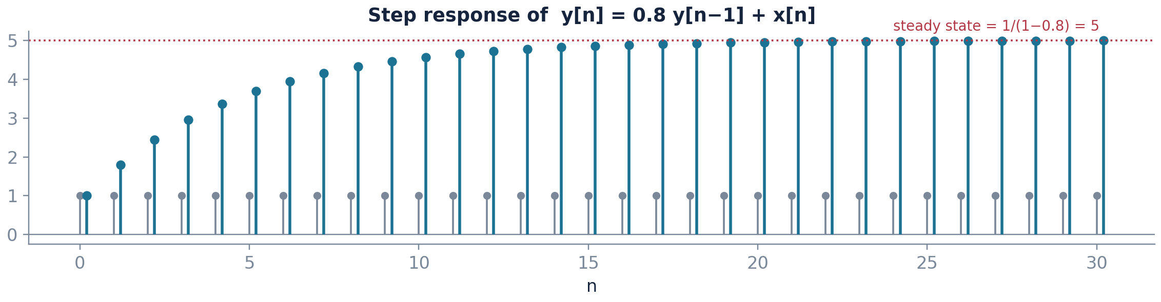
Worked example: a first-order recursive filter
y[n] = 0.8 y[n − 1] + x[n], at rest, driven by a unit step
By iteration
Impulse response
Steady state
y[0] = 1, y[1] = 1.8, y[2] = 2.44, y[3] = 2.95, and so on. Easy to program, tedious by hand, and it gives no closed form.
Setting x[n] = δ[n] gives h[n] = 0.8ⁿ u[n]. Infinite in length, absolutely summable, hence a stable IIR system.
The output settles at 1/(1 − 0.8) = 5, which is the sum of the impulse response. The approach is geometric, never abrupt.
CSE 5112 · Module 1 · Foundations of DSP
51
Notes:
Ask what happens if the coefficient is 1.0 instead of 0.8, and then 1.2. The first gives a pure accumulator and the second diverges. This is the intuition that the z transform will formalise as pole location in Chapter 5.

Slide 46
MATLAB corner: everything in Chapter 3 in one screen
Verify by computation what you proved by hand
%% sequences
n = -5:20;
delta = (n == 0);
u = (n >= 0);
expo = (0.8.^n) .* u;
%% convolution, done three ways
x = [1 2 1 -1]; h = [1 1 0.5];
y1 = conv(x, h);
y2 = filter(h, 1, [x zeros(1,length(h)-1)]);
max(abs(y1 - y2)) % ~1e-16
%% the recursive filter of the previous slide
b = 1; a = [1 -0.8];
step = ones(1,30);
y = filter(b, a, step);
%% impulse response and a stability check
hh = impz(b, a, 60);
sum(abs(hh)) % finite, so BIBO stable
stem(0:29, y); xlabel('n'); ylabel('y[n]')
filter versus conv
Indexing trap
conv assumes zero initial conditions and returns the full length L₁ + L₂ − 1. filter implements the difference equation directly and returns an output the same length as the input, so the two agree only after zero-padding.
MATLAB arrays begin at index 1, so the sample x[0] lives in x(1). Keep a separate index vector n and never rely on the array position to carry time information.
CSE 5112 · Module 1 · Foundations of DSP
52
Notes:
The indexing trap costs students more marks than any conceptual error in this chapter. Make the first laboratory exercise one where an off-by-one in the index vector produces a visibly wrong plot.

Slide 47
CHAPTER FOUR
4
Sampling and Reconstruction
of Analog Signals
Intended learning outcomes
Derive the spectrum of a sampled signal and explain the origin of spectral replicas
State and apply the sampling theorem, and compute alias frequencies
Justify the need for anti-aliasing and reconstruction filters
Estimate the signal-to-noise ratio produced by a given converter word length
Notes:
Chapter 4 is where the analog and digital worlds are joined. It is also the chapter with the most direct engineering consequences, because a wrong sampling rate cannot be fixed later in software.

Slide 48
The question this chapter answers
We keep a few values and throw the rest away. When is that safe to do?
1
The naive worry
2
The surprising answer
3
The price
Between one sample and the next, the signal did something and we did not write it down. It feels obvious that information is gone for good and cannot be recovered.
If the signal has nothing in it faster than half the sampling rate, then nothing at all is lost. The original curve can be rebuilt exactly, everywhere, from the samples alone.
That condition is a real restriction, not fine print. Break it and you do not just lose detail. Fast components fold down and pretend to be slow ones that were never there.
The route to the answer
1
Model sampling as multiplication by an impulse train
2
Transform to frequency, where multiplication becomes convolution
3
Observe that the spectrum is replicated at every multiple of Ωₛ
4
Require the replicas not to overlap; that requirement is the theorem
CSE 5112 · Module 1 · Foundations of DSP
54
Notes:
Set the question up as a genuine puzzle before giving the theorem. Students who have felt the naive worry remember the resolution; students handed the theorem cold treat it as one more formula.

Slide 49
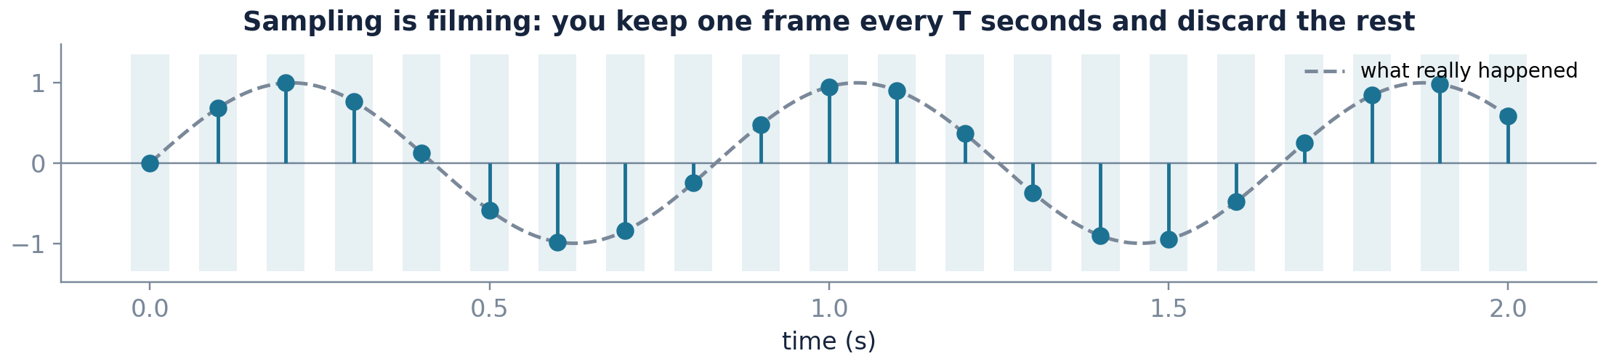
Sampling in plain words
A film shows twenty-four photographs a second and still looks smooth. That is sampling.
A film is a sampled world
A cinema projector shows twenty-four still photographs every second. Between one photograph and the next, the actor moved, and none of that movement was recorded. Yet the film looks continuous, and for ordinary motion it is a perfectly faithful record. That is the sampling theorem working in your favour.
And a film also shows sampling failing
Point a camera at a spinning wheel and the wheel can appear to slow down, stop, or turn backwards. Nothing is wrong with the camera. The wheel is simply turning faster than twenty-four frames a second can follow, and the recorded frames are equally consistent with a much slower rotation. That failure is aliasing, and the rest of this chapter is about predicting exactly when it happens.
CSE 5112 · Module 1 · Foundations of DSP
55
Notes:
Open the sampling chapter with this rather than with the impulse train. Students who hold the film picture in mind find the spectral replica argument far easier, because they already believe the conclusion and are only being shown why it is true.

Slide 50
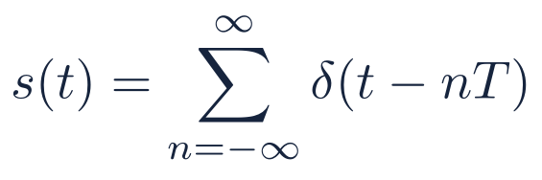
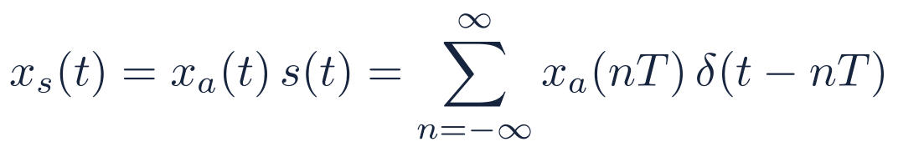
Step one: model sampling as multiplication
A trick that turns sampling into a multiplication we already know how to handle
(4.1)
(4.2)
The impulse train s(t) is just a row of spikes, one every T seconds, where T = 1/fₛ is the gap between samples.
Multiply the signal by that row of spikes and each spike is scaled by the signal value at that instant. Note this is still a continuous-time object; it is not the list x[n], and the difference matters.
We only build xₛ(t) as a stepping stone. Because it lives in continuous time, the Fourier transform from Chapter 2 works on it without any changes.
No real converter makes spikes. This is a shortcut to the right answer, and the effect of what real hardware does is added back later in this chapter.
CSE 5112 · Module 1 · Foundations of DSP
56
Notes:
The distinction between x sub s of t and x of n is a common stumbling block. One is a continuous-time signal built from impulses; the other is a list of numbers. They carry the same information and are not the same object.

Slide 51
Where the replica formula comes from
Four steps, and every one of them was already proved back in Chapter 2
1
Represent the sampler
Model the act of sampling as multiplying the analog signal by a train of impulses spaced T apart. Between impulses the product is zero, so only the sample values survive. Nothing physical is claimed; this is a convenient description.
2
Recall what the impulse train's own spectrum is
The train repeats in time with period T. Anything periodic in time has a line spectrum, so the train's spectrum is itself a train of impulses, this time spaced Ωₛ = 2π/T apart in frequency.
3
Use the multiplication property
Chapter 2 established that multiplying two signals in time convolves their spectra in frequency. So we must convolve the signal's spectrum with a train of impulses.
4
Read off the answer
Convolving anything with a single impulse located at Ω = rΩₛ just moves a copy of it to that location. Convolving with a whole train therefore produces a copy at every multiple of Ωₛ. That is the replica formula, equation 4.3.
Plain words
Sampling does not damage the spectrum. It photocopies it, over and over, along the frequency axis. If the copies land clear of one another, the original is untouched and a filter can cut it out. If they land on top of one another, they add, and an addition cannot be undone.
CSE 5112 · Module 1 · Foundations of DSP
57
Notes:
Emphasise that no step here is new. Every one of the four was proved in Chapter 2, which is the answer to any student who asks why the analog review was necessary.

Slide 52
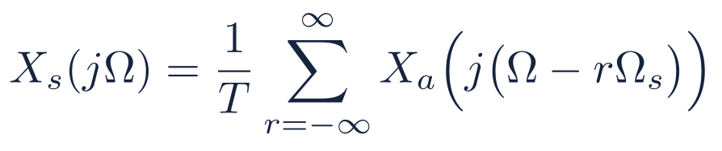
Step two: transform, and the replicas appear
Multiplying in time means the spectrum gets copied along the frequency axis
(4.3)
Read the sum
Why repetition
The consequence
The sampled signal has the original spectrum, shrunk by 1/T, and then copied over and over at every multiple of the sampling frequency.
The row of spikes repeats in time, so its own spectrum is also a row of spikes. Combining with a spike at some frequency simply drops a copy of the spectrum at that frequency.
If the original spectrum is too wide, neighbouring copies run into each other and add together. Once two numbers have been added, no one can tell you what the two were.
Key point Taking samples in time makes the spectrum repeat in frequency. It is the same rule you met in Chapter 2, where a repeating signal gave a spiky spectrum, just used the other way round.
CSE 5112 · Module 1 · Foundations of DSP
58
Notes:
Draw the duality explicitly: periodic in one domain means discrete in the other, in both directions. Students who see the symmetry stop treating equation 4.3 as an isolated fact to memorise.

Slide 53
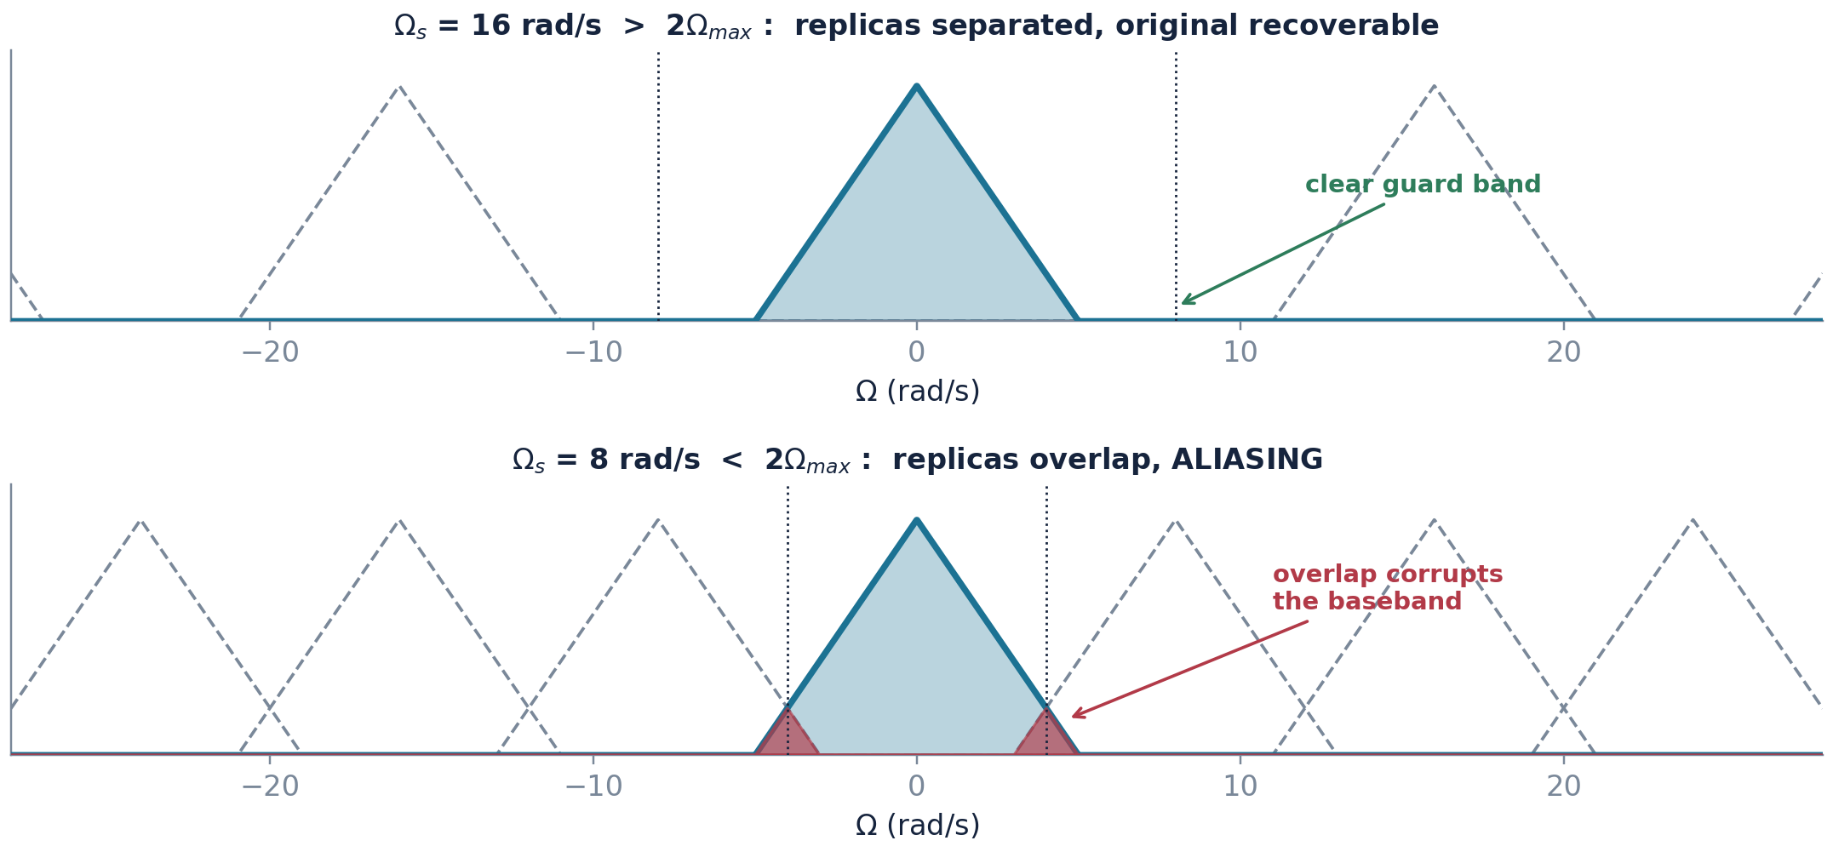
The picture that carries the whole theorem
One signal, two sampling rates, two completely different outcomes
Solid blue is the baseband spectrum; dashed grey are the replicas created by sampling. Dotted vertical lines mark ±Ωₛ/2.
Key point In the top picture a filter can cut out the blue triangle on its own, and the original comes back perfectly. In the bottom picture the red areas belong to two copies at once, and no filter can separate a sum back into its parts.
CSE 5112 · Module 1 · Foundations of DSP
59
Notes:
Spend real time here. If students can reproduce this figure from memory and explain what the red regions mean, they understand the sampling theorem. Everything else in the chapter is bookkeeping around this picture.

Slide 54
How to read the replica picture
Going through the figure piece by piece, because it carries the whole chapter
1
The solid blue triangle in the middle
This is the original signal's spectrum, sitting where it always was. Its width tells you the highest frequency the signal contains.
2
The dashed grey triangles
These are the copies created by sampling. They are not real signal; they are an artefact of having taken samples. They repeat forever in both directions.
3
The spacing between copies
Exactly Ωₛ, the sampling frequency. Sample faster and the copies move further apart; sample slower and they crowd together. This is the only thing you control.
4
The dotted vertical lines at ±Ωₛ/2
The boundary of the usable band. Everything a sampled signal can represent lies between these two lines, and nothing outside them is new information.
5
The red shading in the lower panel
Where two copies overlap and add. Those frequencies now contain a sum of two contributions, and there is no operation that can separate a sum back into its parts.
The question to ask of any sampling problem
Does the blue triangle reach past the dotted line before the first grey copy arrives? If it does not, you are safe: an ideal low-pass filter recovers the original exactly. If it does, information is already lost and no later processing brings it back. Every sampling question in this course reduces to that check.
CSE 5112 · Module 1 · Foundations of DSP
60
Notes:
Ask individual students to point at each element on the projected figure rather than describing it yourself. Reading the figure aloud is a skill, and it is the skill being examined.

Slide 55
THE SAMPLING THEOREM
A band-limited signal is fully determined
by its samples if the sampling rate exceeds
twice the highest frequency present
Nyquist, Kotelnikov, Whittaker and Shannon all have a claim to this result. The threshold 2fₐₓ is the Nyquist rate; half the sampling rate, fₛ/2, is the folding or Nyquist frequency. The inequality is strict: sampling a pure sinusoid at exactly twice its frequency can land every sample on a zero crossing.
Notes:
Mention the edge case in the last sentence and demonstrate it if there is time. Sampling sin(2 pi t) at exactly 2 Hz starting at t equals zero gives all zeros, which is why the theorem uses a strict inequality.

Slide 56
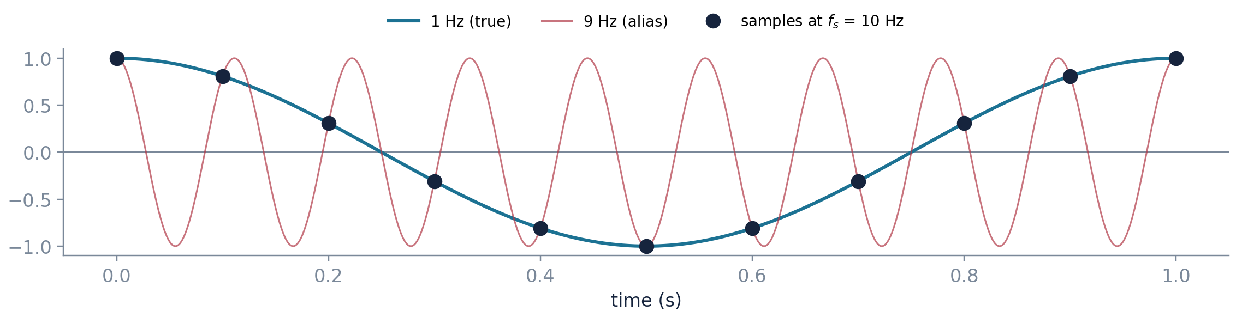
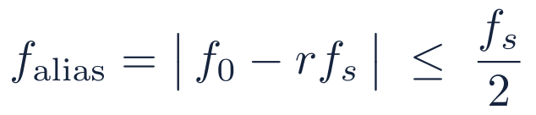
Aliasing seen in the time domain
Two different tones, sampled, give exactly the same set of numbers
(4.4)
Choose the integer r that brings the result into the band
A 7 kHz tone sampled at 10 kHz is indistinguishable from 3 kHz
Key point Aliasing is not distortion in the usual sense. The false tone is a perfectly clean wave sitting in the wrong place, and that is exactly why no filter can remove it later.
CSE 5112 · Module 1 · Foundations of DSP
62
Notes:
Everyday example: the wagon wheel that appears to turn backwards in a film, sampled at twenty-four frames per second. Ask the class for others, such as strobe lighting on rotating machinery.

Slide 57
Aliasing outside the classroom
Four things you have already seen that are all this one piece of mathematics
1
The wagon wheel in a western
2
Strobe lighting on machinery
Spokes appear to rotate slowly backwards. The camera samples at twenty-four frames a second and the wheel turns faster than that, so each frame is consistent with a small backward step.
Under a strobe a rotating shaft can look motionless. This is aliasing used deliberately, and it is also a genuine industrial hazard, because a shaft that appears stopped is still turning at full speed.
3
Moiré patterns on a striped shirt
4
Beats when tuning an instrument
A shirt with fine stripes filmed by a digital camera develops rippling coloured bands. The camera's pixel grid is sampling space too coarsely for the stripe spacing, and the stripes alias into a slower pattern.
Two nearly equal tones produce a slow throb. This is the same folding arithmetic, |f₁ − f₂|, that gives the alias frequency, and it is why the effect is audible rather than merely theoretical.
The common thread
In every case a fast thing is being observed at a slower rate, and the observations are equally consistent with a slow thing. The observer is not making a mistake; the data genuinely does not distinguish the two. That is why aliasing must be prevented before the measurement rather than corrected after it.
CSE 5112 · Module 1 · Foundations of DSP
63
Notes:
Ask the class for a fifth example from their own field. Mechanical students usually offer stroboscopic tachometers, and computer science students offer texture aliasing in graphics, which is the same theorem in two spatial dimensions.

Slide 58
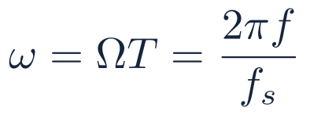
The frequency map you will use in every later chapter
How to turn kilohertz into the ω that every later chapter uses
(4.5)
Analog frequency f
Normalised ω
Interpretation
What the sequence looks like
0
0
DC
Constant offset, passes everything
fₛ/8
π/4
Low
Comfortably inside the band
fₛ/4
π/2
Mid
Quarter-rate; four samples per cycle
fₛ/2
π
Highest representable
Two samples per cycle, the folding frequency
fₛ
2π
Indistinguishable from DC
One sample per cycle, every sample identical
Key point From Chapter 5 on, frequency axes run in ω from 0 to π. Turning a spec like cut off at 3.4 kHz with fₛ = 8 kHz into ω = 0.85π is step one of every filter design question you will be given.
CSE 5112 · Module 1 · Foundations of DSP
64
Notes:
Drill this conversion until it is automatic. In Chapters 10 and 11 students lose marks not because they cannot design a filter but because they specified the wrong normalised cut-off frequency at the start.

Slide 59
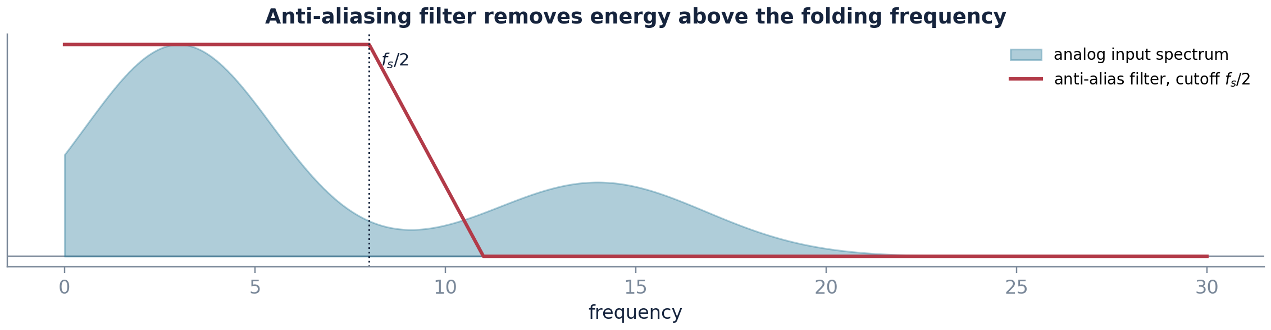
The anti-aliasing filter
The one block that has to be analog, and why it cannot wait until later
Why before the sampler
Once folding has happened, the false parts sit right inside the band you care about, on top of the real signal. Nothing you do afterwards can separate them.
Why it cannot be digital
A digital filter works on samples, and by the time the samples exist the damage is already done. This filter has to act on the smooth waveform first.
Why it is never ideal
A real filter cannot switch off instantly. It needs room to fall away, so we sample a little faster than the strict minimum.
In practice A music CD samples at 44.1 kHz even though hearing stops around 20 kHz. That extra 4.1 kHz exists purely so the anti-aliasing filter has room to fall away.
CSE 5112 · Module 1 · Foundations of DSP
65
Notes:
The compact-disc number is a good anchor because students already know it. Ask them to work out the required filter order for a brick-wall response at exactly 20 kHz, which is how the answer becomes obviously impractical.

Slide 60
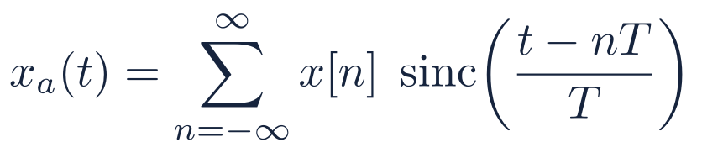
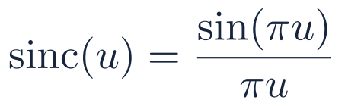
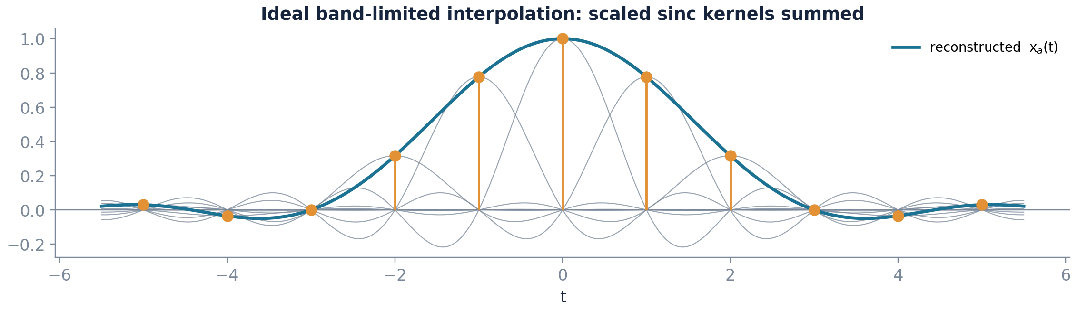
Ideal reconstruction: interpolation with sinc functions
Joining the dots back into a smooth curve, and doing it correctly
(4.6)
(4.7)
Every sample gets its own sinc shape, centred on it. Each sinc happens to be exactly zero at all the other sample points, so the total passes through every dot perfectly.
CSE 5112 · Module 1 · Foundations of DSP
66
Notes:
The key structural fact is that sinc of zero equals one and sinc of any other integer equals zero. That is what makes the interpolation exact at the sample points and it is worth showing on the board.

Slide 61
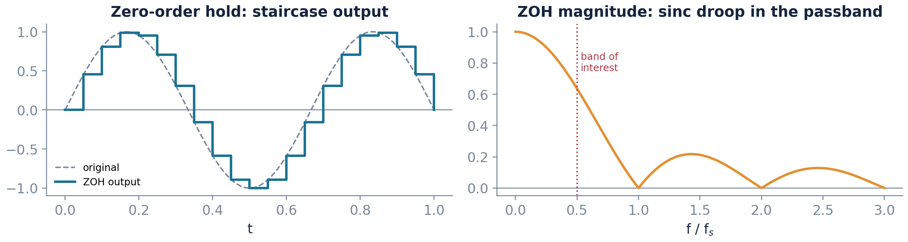
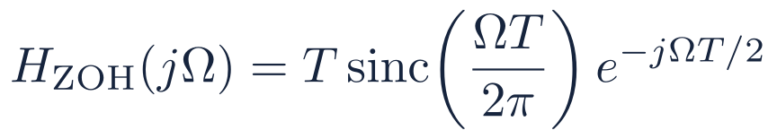
Why the ideal reconstructor cannot be built
The perfect method needs the future. Here is what real hardware does instead.
The obstruction
The practical substitute
The sinc extends over all time in both directions, so producing the output at t requires samples arbitrarily far in the future.
It also fades very slowly, so cutting it short introduces error unless you keep a great many terms.
The matching filter would have to switch off instantly at one frequency, and no real circuit can do that.
Hold each sample steady until the next one turns up. This is called a zero-order hold, and it is literally what a converter chip does.
Then put a gentle analog filter after it to smooth off the staircase corners.
Finally correct the slight loss of high frequencies, either in that filter or digitally beforehand.
CSE 5112 · Module 1 · Foundations of DSP
67
Notes:
The sinc droop in the right panel is real and measurable: at the band edge a zero-order hold attenuates by about 3.9 dB. Audio equipment corrects for it, which is a nice example of a digital fix for an analog defect.

Slide 62
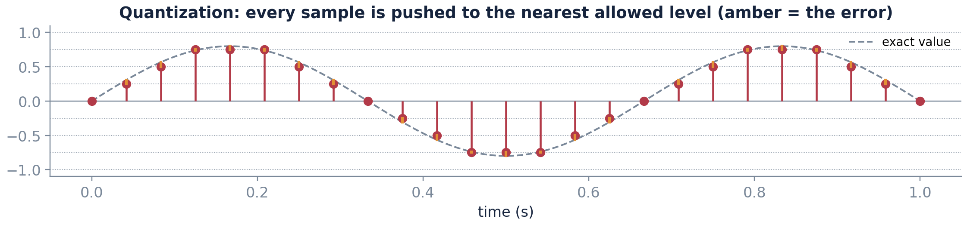
Quantization in plain words
Rounding every sample to the nearest allowed level, like rounding a price to whole taka
Rounding to the nearest note
Suppose you may only record amounts in whole taka. A price of 36.40 becomes 36 and a price of 36.80 becomes 37. Nothing about the shop has changed; your recording system simply cannot express anything finer. Quantization is exactly this, applied to every sample of the signal.
How the number of bits enters
B bits give you 2 to the power B different levels to choose from. Eight bits gives 256 levels, sixteen bits gives 65,536. Spread those levels across the full input range and the gap between neighbouring levels is Δ. Every sample lands within half a gap of its true value, so the error is never worse than Δ/2.
The difference that matters
Aliasing is a disaster; quantization is a budget item. Aliasing puts a false signal inside your band and cannot be undone. Quantization adds a small, known error that halves with every extra bit.
CSE 5112 · Module 1 · Foundations of DSP
68
Notes:
The taka analogy works better than the usual voltage example because everybody has an intuition for rounding money, including the intuition that rounding many transactions produces a small overall error rather than a disaster.

Slide 63



Quantization: the second approximation
Sampling cuts up time. Quantization cuts up height. Two separate costs.
(4.8)
(4.9)
Step size for B bits over a full-scale range of ±Xₘₐₓ
Error power, assuming the error is uniform over one step
Key point Unlike aliasing, this error has a known limit and it halves every time you add one bit. It is a cost to budget for, not a disaster to avoid.
CSE 5112 · Module 1 · Foundations of DSP
69
Notes:
Note the assumption behind equation 4.9: the error is modelled as uniformly distributed white noise independent of the signal. That model fails for very small or very periodic signals, which is why dither is used in high-quality audio.

Slide 64

The six decibels per bit rule
One extra bit buys you a fixed amount of accuracy. Here is exactly how much.
(4.10)
Word length B
Best-case SNR
Typical use
8
≈ 50 dB
Basic telephony, simple instrumentation
12
≈ 74 dB
Industrial data acquisition, control loops
16
≈ 98 dB
Compact-disc audio, most biomedical recording
24
≈ 146 dB
Studio mastering; well below the analog noise floor of most front ends
That number is the best case, for a signal that fills the whole input range. Any smaller signal does worse, by exactly the amount of range it leaves unused.
Past about twenty bits, the noise of the amplifier in front takes over. Extra bits then improve the number on the datasheet and not the actual measurement.
CSE 5112 · Module 1 · Foundations of DSP
70
Notes:
The practical lesson is about gain staging, not about buying expensive converters. A sixteen-bit converter fed a signal at ten percent of full scale performs like a roughly thirteen-bit converter, and no amount of processing recovers those bits.

Slide 65
Worked example in full: what SNR will I actually get?
A real number for a real converter, with every step written out
1
Start from the best case
The rule gives the SNR for a signal that uses the entire input range. For B = 12, that is 6.02 times 12 plus 1.76, which comes to about 74 decibels. This is a ceiling, not a promise.
2
Work out the headroom you are wasting
The signal peaks at one quarter of full scale, so three quarters of the converter's range is never used. A factor of four in amplitude is 20 log₁₀(4), which is about 12 decibels.
3
Subtract it
Those 12 decibels are gone. The quantization error does not shrink when the signal does; the step size Δ was fixed the moment the converter and its range were chosen. So the achieved SNR is roughly 74 minus 12.
4
State the answer and the lesson
About 62 decibels, which is what a ten-bit converter would have given at full scale. Two bits have been thrown away by poor gain staging, and no amount of later processing recovers them.
What to do about it in practice
Put an adjustable amplifier before the converter and set its gain so the largest expected signal just fills the input range. This usually buys more real accuracy than upgrading the converter. Clipping is far worse than wasted headroom, so leave a safety margin.
CSE 5112 · Module 1 · Foundations of DSP
71
Notes:
This is the single most practically useful calculation in the module. Engineers who never touch a transform again will still meet gain staging on their first instrumentation job.

Slide 66
Putting it together: specifying a data acquisition chain
Choosing a sampling rate and a word length for an actual instrument
1
Identify the band of interest
Signs of a failing bearing show up to about 10 kHz. Anything faster than that tells us nothing useful here.
fₘₐₓ = 10 kHz
2
Choose the sampling rate
Twice 10 kHz is 20 kHz, so that is the minimum. Sample at 25.6 kHz instead to give the filter room. This is a standard rate on vibration instruments.
fₛ = 25.6 kHz
3
Specify the anti-aliasing filter
Let everything below 10 kHz through, and block everything above 12.8 kHz. The blocking has to be strong enough to reach the converter noise floor, about 96 dB for 16 bits.
8th-order analog low pass
4
Choose the word length
The gap between a healthy bearing and an early fault is about 70 dB. Sixteen bits gives 98 dB, which leaves comfortable room.
B = 16 bits
Check the consequences
A 12 kHz component that slips through would alias to 25.6 − 12 = 13.6 kHz, outside the band of interest. A 20 kHz component would alias to 5.6 kHz, squarely inside it and indistinguishable from a real fault.
5
This is why step 3 matters
CSE 5112 · Module 1 · Foundations of DSP
72
Notes:
This is the shape of the design question students will meet in the examination and in practice. Insist that step five is written out; predicting where a specific out-of-band component lands is what distinguishes understanding from formula substitution.

Slide 67
MATLAB corner: watch aliasing happen
Ten lines that let you watch a 7 kHz tone turn into 3 kHz
%% one signal, two sampling rates
f0 = 7000; fs1 = 40000; fs2 = 10000;
t = 0 : 1/fs1 : 0.004; % dense, effectively analog
n = 0 : 1/fs2 : 0.004; % undersampled
plot(t, cos(2*pi*f0*t)); hold on
stem(n, cos(2*pi*f0*n), 'filled')
plot(t, cos(2*pi*3000*t), '--') % the 3 kHz alias
% the dashed 3 kHz curve passes through every sample
Exercise 1
Change f0 to 3 kHz and confirm the samples now trace the correct waveform.
Exercise 2
Set f0 to 5 kHz, exactly fₛ/2, and vary the start phase. Explain why the sampled amplitude changes.
Exercise 3
Quantize the samples to 4 bits with round(x*8)/8 and plot the error. Confirm it stays within ±Δ/2.
Exercise 4
Reconstruct with interp1 using linear interpolation and compare against the sinc formula of equation 4.6.
Key point Exercise 2 is the edge case in the sampling theorem made concrete. At exactly fₛ/2 the recovered amplitude depends on phase, which is why the inequality in the theorem is strict.
CSE 5112 · Module 1 · Foundations of DSP
73
Notes:
Set these four as the first laboratory sheet. Exercise 4 previews interpolation error and gives a natural opening for a discussion of oversampling in the next lecture.

Slide 68
Module 1 in one page
Six results. If you keep only these, you are ready for Module 2.
1
A signal is something that changes; a system turns one into another
Chapter 1
Everything else is detail about which signals and which systems.
2
Combining in time is just multiplying in frequency
Chapter 2
This is the reason we bother with frequency at all.
3
A discrete cosine does not always repeat
Chapter 3
Discrete time does not simply copy the rules you already know.
4
Linear plus time invariant gives you the convolution sum
Chapter 3
One measured impulse response tells you everything about the system.
5
Sampling copies the spectrum over and over along the frequency axis
Chapter 4
Copies that overlap can never be pulled apart again.
6
Sample fast enough and nothing at all is lost
Chapter 4
The one decision that no amount of software can fix later.
CSE 5112 · Module 1 · Foundations of DSP
74
Notes:
Use this as the revision slide before the mid-semester assessment. If a student can state all six and give one consequence of each, they are ready for Module 2.

Slide 69
Six things students reliably get wrong
Named in advance so you do not have to learn them the hard way
✕
“Discrete-time and digital mean the same thing”
✕
“y[n] = x[n] + 3 is linear”
They do not. Discrete-time signals have exact amplitudes; digital signals do not. Almost all analysis in this course assumes the former.
It is not. A constant offset violates superposition. The everyday meaning of linear includes an intercept; the systems meaning does not.
✕
“h[n] tending to zero means the system is stable”
✕
“Sampling faster always gives a better result”
Not sufficient. The condition is absolute summability. The sequence 1/n decays to zero and its sum diverges.
Only up to a point. Beyond the Nyquist requirement, extra rate buys filter headroom and nothing else, while costing storage, power, and processing time.
✕
“Aliasing can be filtered out afterwards”
✕
“More bits always means a better measurement”
It cannot. The aliased component is a clean sinusoid sitting inside the band of interest, mathematically identical to a genuine one.
Only while the converter is the limiting element. Past roughly twenty bits the analog front end dominates, and poor gain staging wastes bits faster than any specification recovers them.
CSE 5112 · Module 1 · Foundations of DSP
75
Notes:
Show this slide twice: once at the end of the module and once again a week before the examination. Naming a misconception out loud is more effective than restating the correct version a third time.

Slide 70
Self-check questions
Eight questions, no notes. If all eight are fine, this module is done.
1
Is x[n] = cos(3n) periodic? If so, give N. If not, explain what fails.
2
Give an impulse response that is stable and non-causal, and one that is causal and unstable.
3
Compute {2, −1, 3} * {1, 1} by hand and check the length of your answer.
4
A system obeys y[n] = x[n] − x[n − 1]. Find h[n], and state whether it is FIR or IIR.
5
A 9 kHz tone is sampled at 8 kHz. What frequency will be observed, and why can it not be removed later?
6
Convert a cut-off specification of 1.2 kHz at fₛ = 8 kHz into normalised frequency ω.
7
A 12-bit converter is fed a signal that peaks at one quarter of full scale. Estimate the achieved SNR.
8
Explain in two sentences why the anti-aliasing filter cannot be implemented digitally.
Key point Questions 1 to 4 test Chapter 3, questions 5 to 8 test Chapter 4. Worked solutions are distributed after the tutorial, not before.
CSE 5112 · Module 1 · Foundations of DSP
76
Notes:
Question 7 is the discriminating one. The answer is roughly 74 minus 12, that is about 62 dB, because a quarter of full scale costs 12 dB of headroom. Students who quote 74 dB have not understood the assumption behind the rule.

Slide 71
Glossary in plain language
Every word this module used, said once more with no symbols at all
Signal
A quantity that varies and carries information. A sound, a voltage, a row of pixels, a share price.
LTI
Linear and time invariant. Doubling the input doubles the output, and delaying the input only delays the output.
System
Anything that takes a signal in and puts a signal out. A filter, a room, a microphone, an algorithm.
Spectrum
The ingredients list of a signal: which simple tones it contains and how much of each.
Sample
One reading of a signal, taken at one instant. x[7] is the eighth such reading, counting from zero.
Nyquist rate
Twice the highest frequency in the signal. Sample faster than this and nothing is lost.
Sampling rate fₛ
How many readings are taken per second. The single most important design choice in the chain.
Aliasing
A fast component pretending to be a slow one because the sampling was too slow. Cannot be repaired afterwards.
Impulse response h[n]
What comes out of a system when you give it one short tap. It describes the system completely, if the system is LTI.
Quantization
Rounding each sample to one of a fixed set of levels, because a computer stores a finite number of bits.
Convolution
The recipe for combining an input with an impulse response: lay down a scaled, shifted copy for every input sample and add them all up.
FIR and IIR
Filters whose impulse response either stops after a while (FIR) or goes on forever (IIR).
CSE 5112 · Module 1 · Foundations of DSP
77
Notes:
Tell students to keep this page open on a second screen during the first few problem sets. Most of what feels like conceptual difficulty in weeks two and three is actually vocabulary difficulty.

Slide 72
Symbols used in this module
What each letter means, and what units to expect with it
Symbol
What it means
Units to expect
xₐ(t), y(t)
An analog signal, defined at every instant
volts, pascals, degrees
x[n], y[n]
A discrete-time signal, defined only at sample instants
same units, but no time inside
n
The sample index, an integer counter
none; it is a count
T
The sampling period, the gap between samples
seconds
fₛ = 1/T
The sampling rate
hertz, samples per second
Ω
Analog angular frequency
radians per second
f
Analog frequency, f = Ω/2π
hertz
ω = ΩT
Normalised discrete-time frequency
radians per sample; only −π to π matters
δ[n], u[n]
The unit impulse and the unit step sequences
none
h[n]
The impulse response of a system
gain per sample
*
Convolution, not ordinary multiplication
—
B, Δ
Converter word length in bits, and the resulting step size
bits; volts
Two conventions that cause most of the confusion
First, round brackets always mean continuous time and square brackets always mean discrete time. Second, Ω and ω are different quantities and are never interchangeable, however similar they look on a whiteboard. Textbooks differ, so check the front matter of whichever book you read.
CSE 5112 · Module 1 · Foundations of DSP
78
Notes:
Print this page and the glossary as a single double-sided handout for the first lecture. It removes a surprising amount of friction for students coming from other departments.

Slide 73
What comes next
Module 2 makes convolution as easy as ordinary multiplication
Chapter 5
Chapter 6
Chapter 7
z transform
Discrete-time Fourier transform
DFS, DFT, and the FFT
Convolution becomes multiplication of polynomials. Poles and zeros make stability visible at a glance, and the region of convergence decides whether a system is causal.
The frequency response of a filter, defined properly at last. Magnitude tells you what survives; phase tells you how much it is delayed.
A transform a computer can actually evaluate, and the algorithm that made real-time spectral analysis possible.
Preparation for the first Module 2 lecture
Revise geometric series, including the condition for convergence. The z transform of aⁿ u[n] is nothing more than a geometric series, and every standard transform pair in Chapter 5 follows from it.
Revise partial fraction expansion for rational functions with distinct and with repeated roots. Inverse z transforms are computed this way throughout Chapter 5.
Be fluent with complex numbers in polar form. Poles and zeros are points in a complex plane and their distance from the unit circle is what shapes a frequency response.
CSE 5112 · Module 1 · Foundations of DSP
79
Notes:
The three preparation items are genuinely worth setting as homework. Students who arrive at Chapter 5 shaky on partial fractions spend the whole chapter fighting algebra instead of learning the transform.

Slide 74
Reading and further study
Three books, and what each one is actually good for
Oppenheim and Schafer, Discrete-Time Signal Processing
The standard graduate reference. Rigorous, complete, and demanding. Use it for the definitive statement of any result in this course, and for the problem sets at the end of each chapter.
Primary reference
Proakis and Manolakis, Digital Signal Processing
More worked examples and a gentler slope, with strong coverage of filter design and practical implementation. Use it when a derivation in the primary text moves too fast.
Worked examples
Gonzalez and Woods, Digital Image Processing
The reference for the second half of this course. Chapters on spatial and frequency-domain filtering build directly on the material in this module.
Second half of CSE 5112
A note on lecture notes
Several well-regarded open lecture note sets follow essentially this chapter sequence, including those of H. C. So at City University of Hong Kong. Students are encouraged to consult them alongside the textbooks. This deck is an independent teaching aid and is not a substitute for either.
CSE 5112 · Module 1 · Foundations of DSP
80
Notes:
Be explicit with students about which text is the examinable reference. If assessment questions are drawn from Oppenheim and Schafer, say so at the start of the semester rather than at revision time.

Slide 75
END OF MODULE 1
Convolution and Nyquist.
Everything else is
construction on top.
Next: the z transform, and the moment convolution stops being an infinite sum and becomes ordinary algebra.
Notes:
Close on the two results rather than a list of topics. If students remember one sentence from this module a year from now, this is the one worth having.

